Slide 1
WORKac:
North Boulder
Branch Library
Community Engagement Events, March 2019

Slide 2
READING BOULDER
A CITY IN NATURE

Slide 3
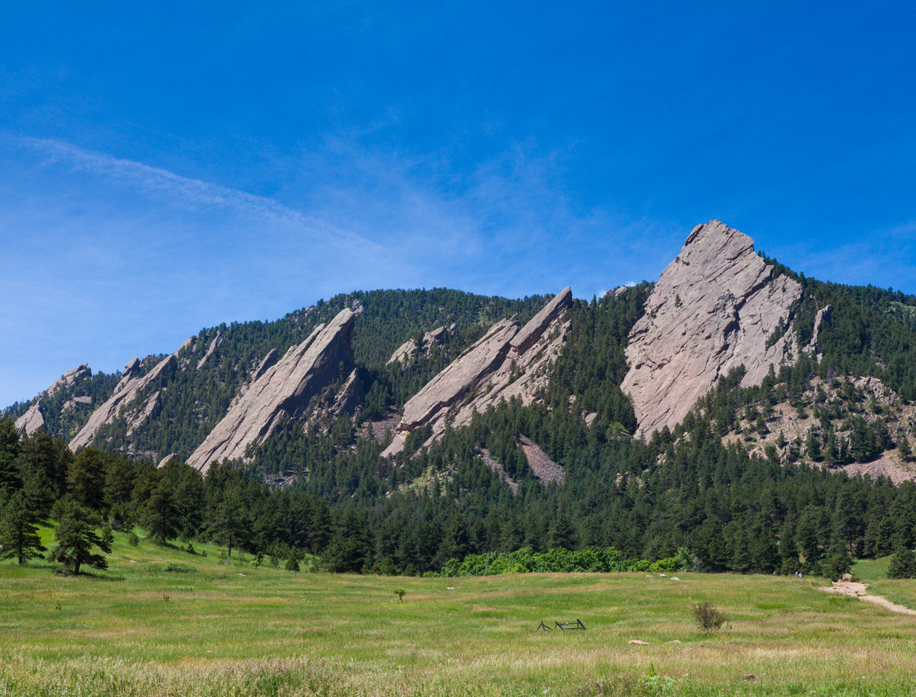
MOUNTAIN VIEWS / PANORAMA

Slide 4
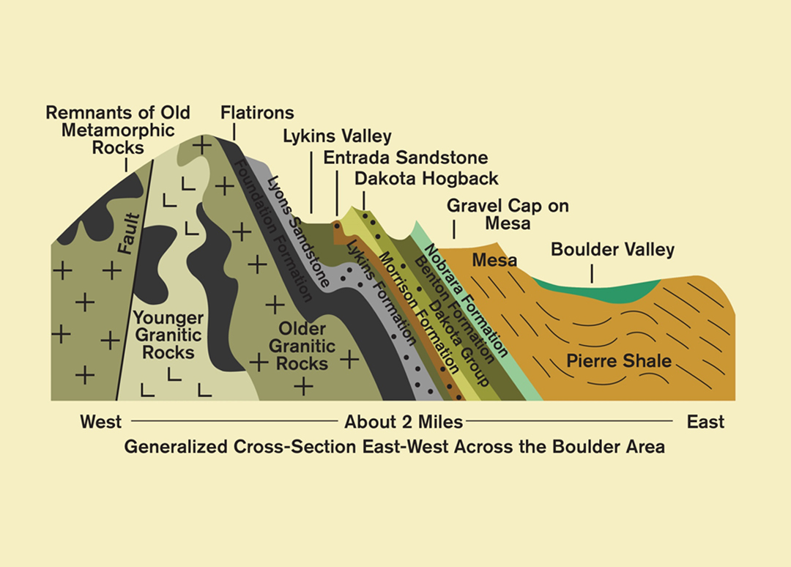
GEOLOGY

Slide 5
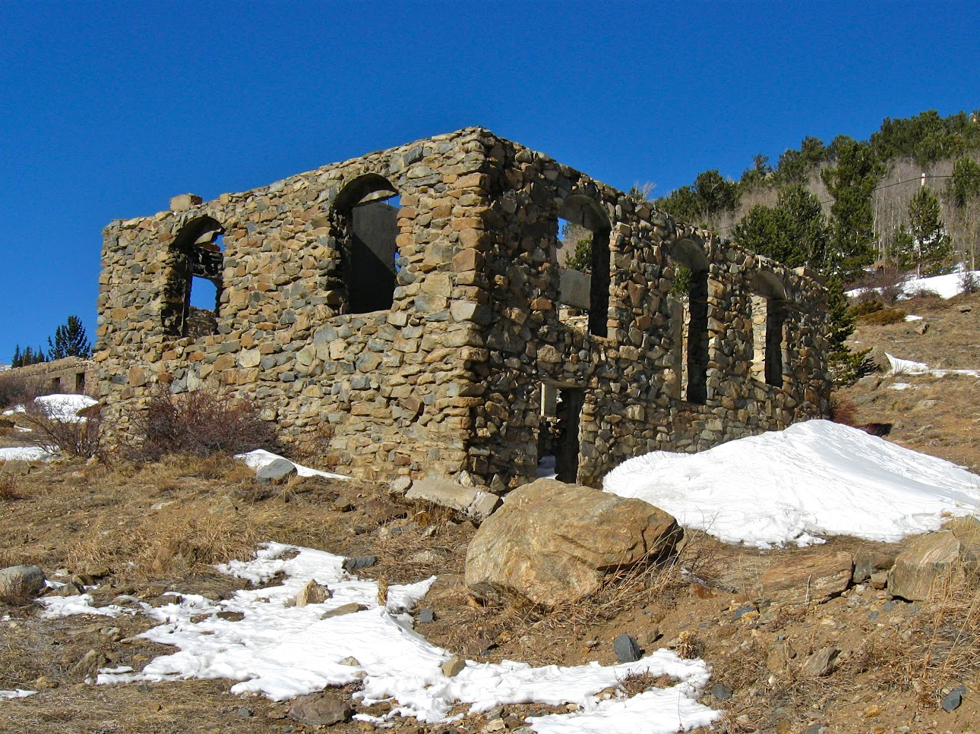
VERNACULAR: NATURAL STONE + RUGGEDNESS

Slide 6
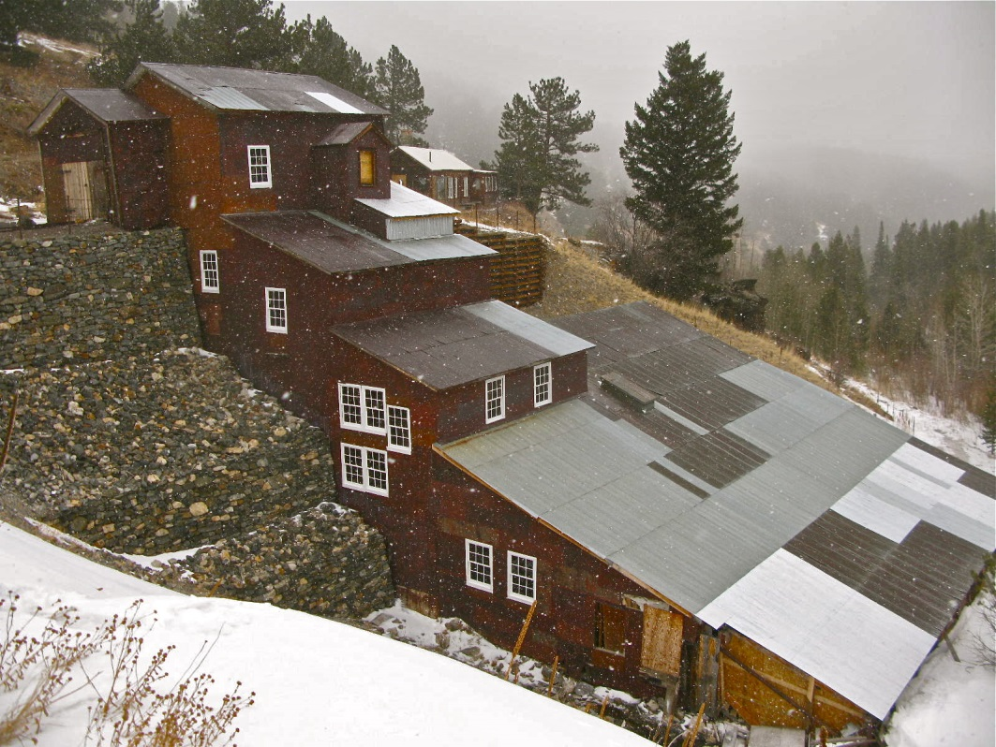
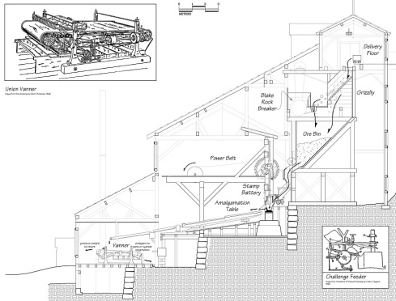
TOPOGRAPHY + SYSTEMS

Slide 7
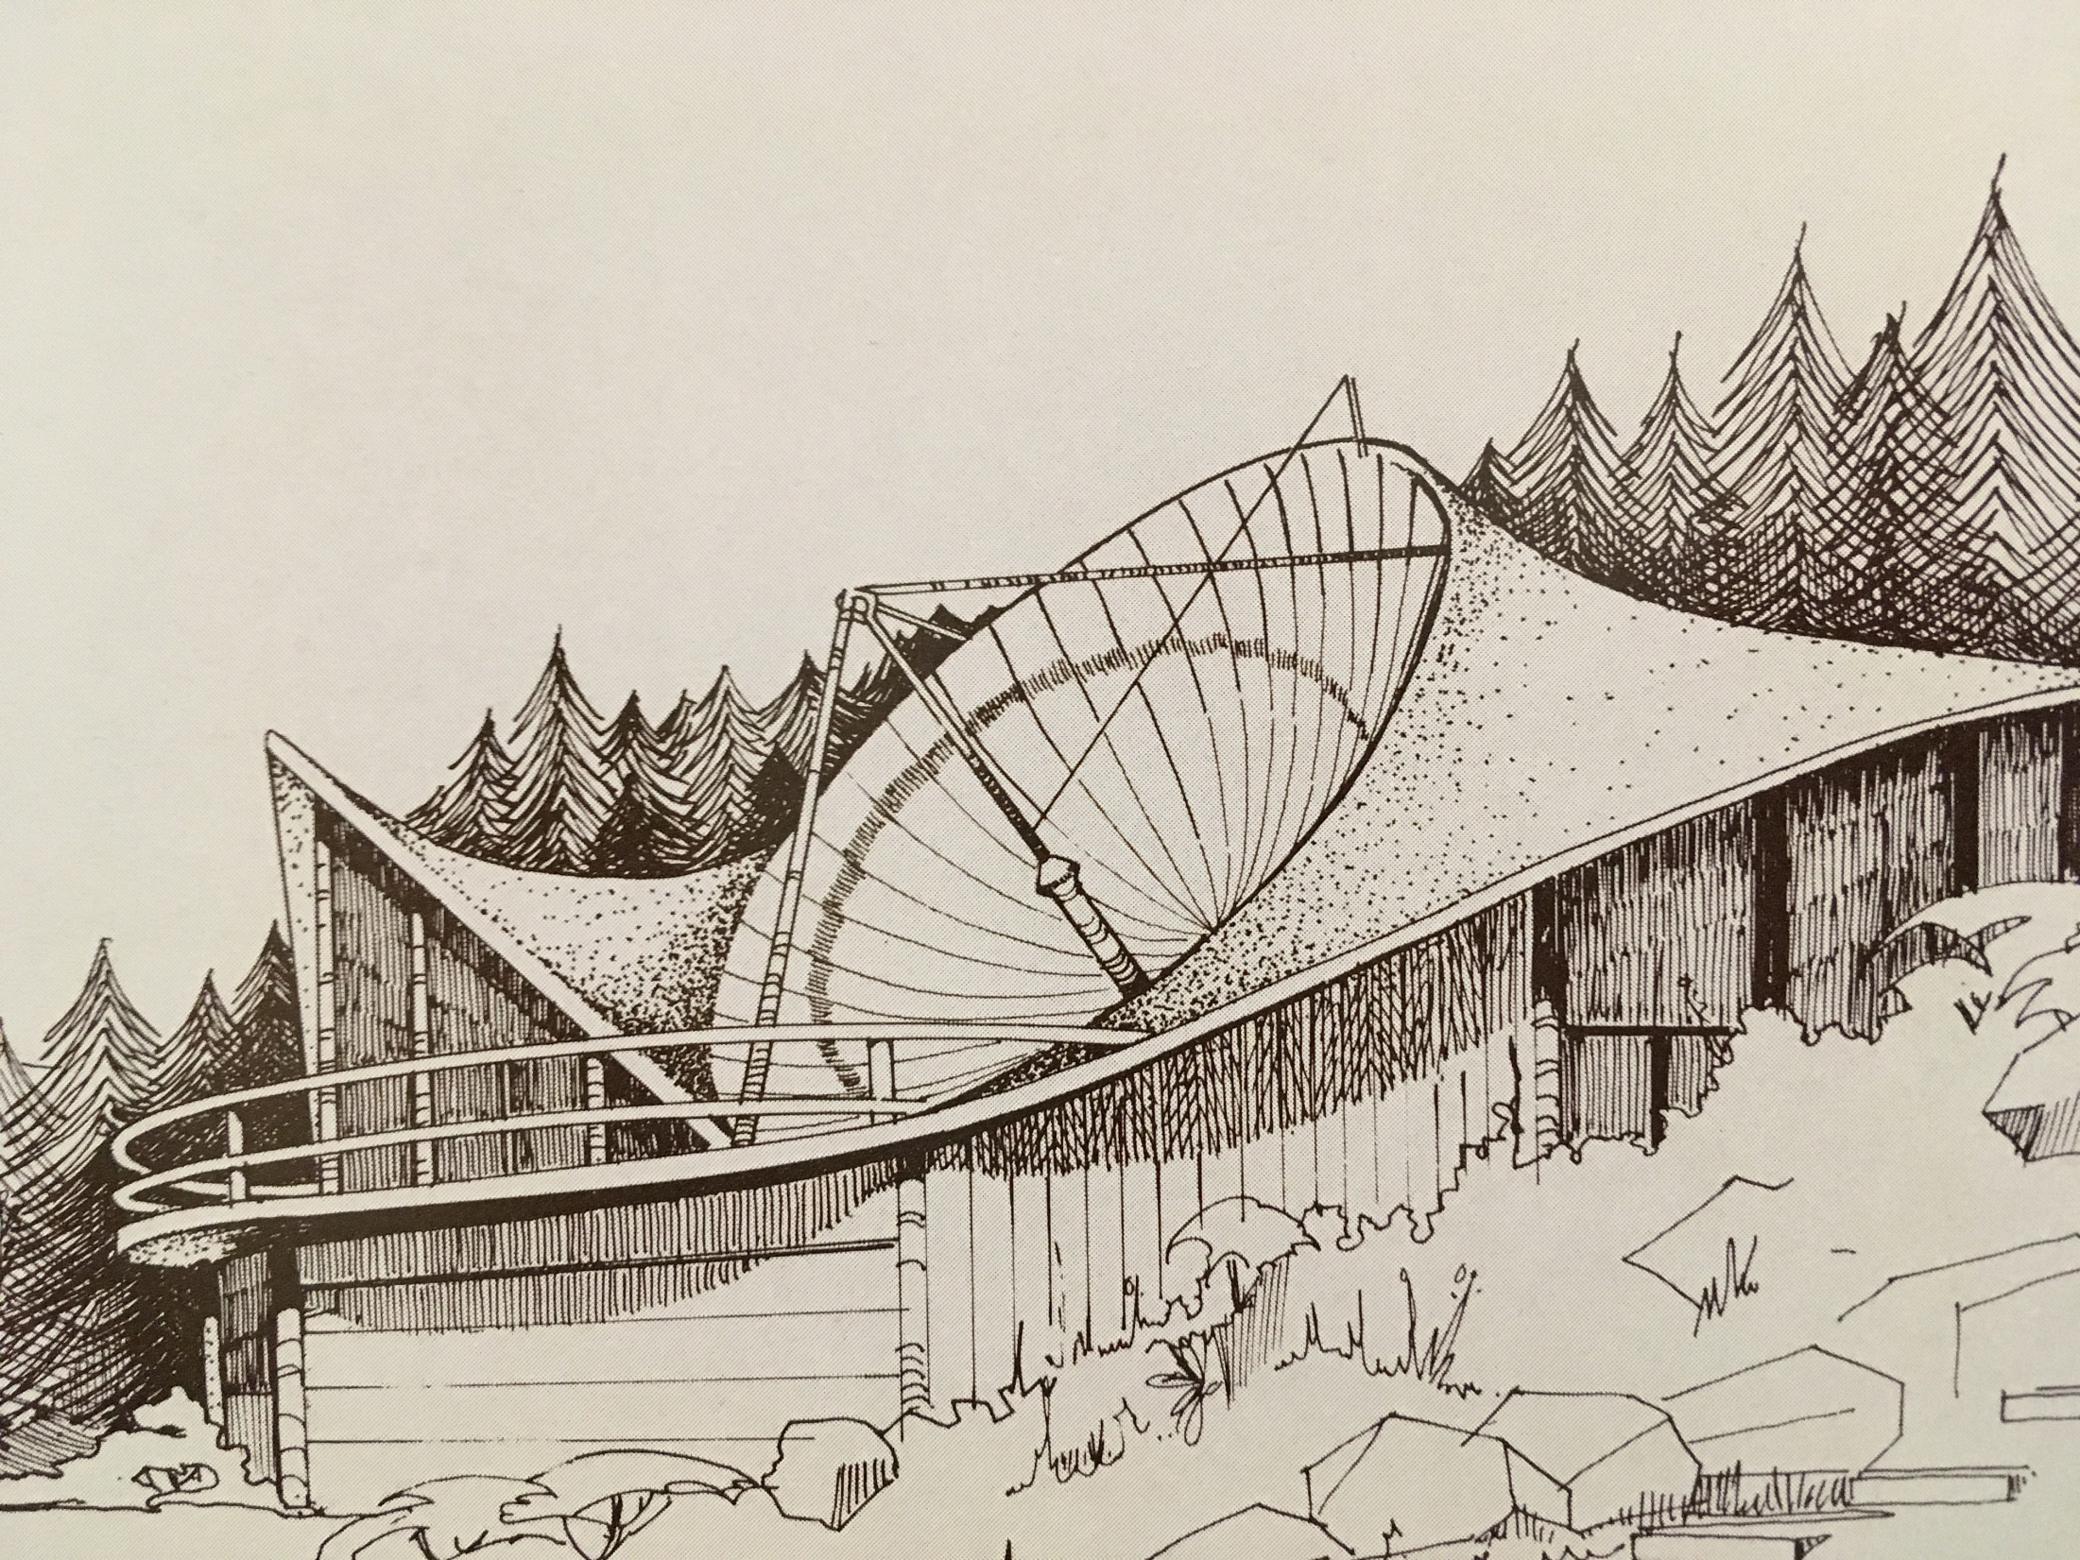
SYSTEMS

Slide 8
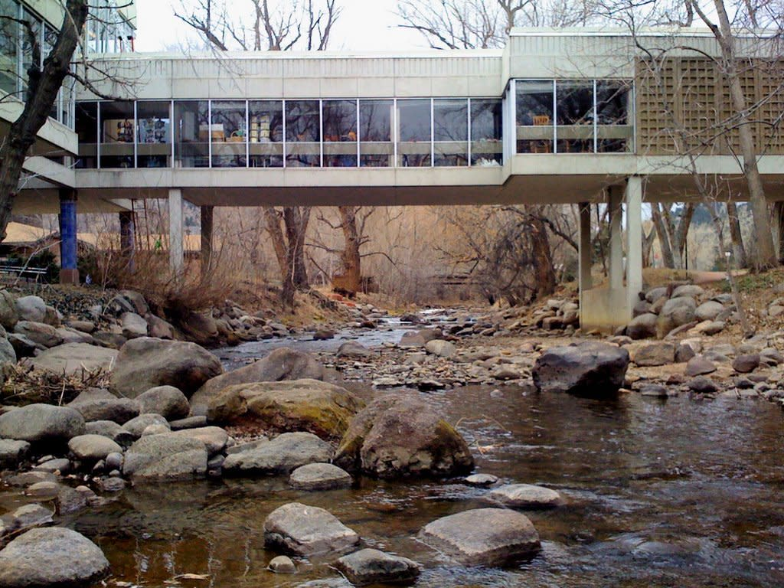
INSIDE + OUTSIDE

Slide 9
READING BOULDER
COMMUNITIES

Slide 10
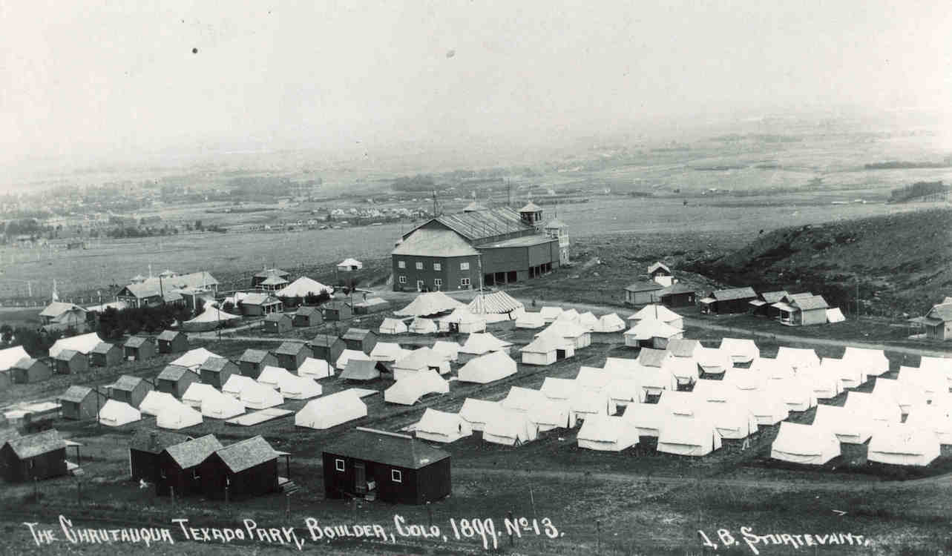
PIONEERING COMMUNITIES

Slide 11
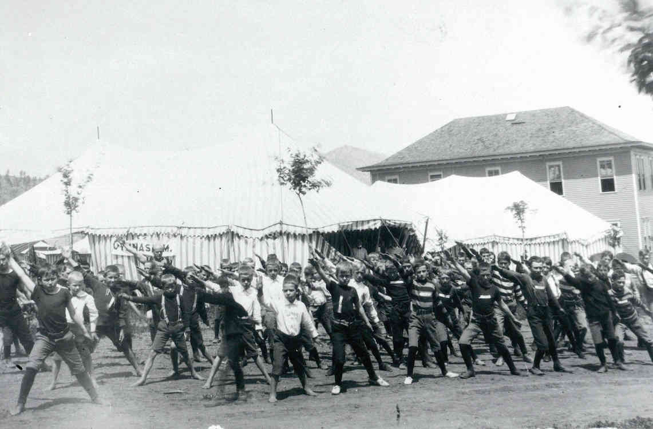
BUILDING COMMUNITIES

Slide 12
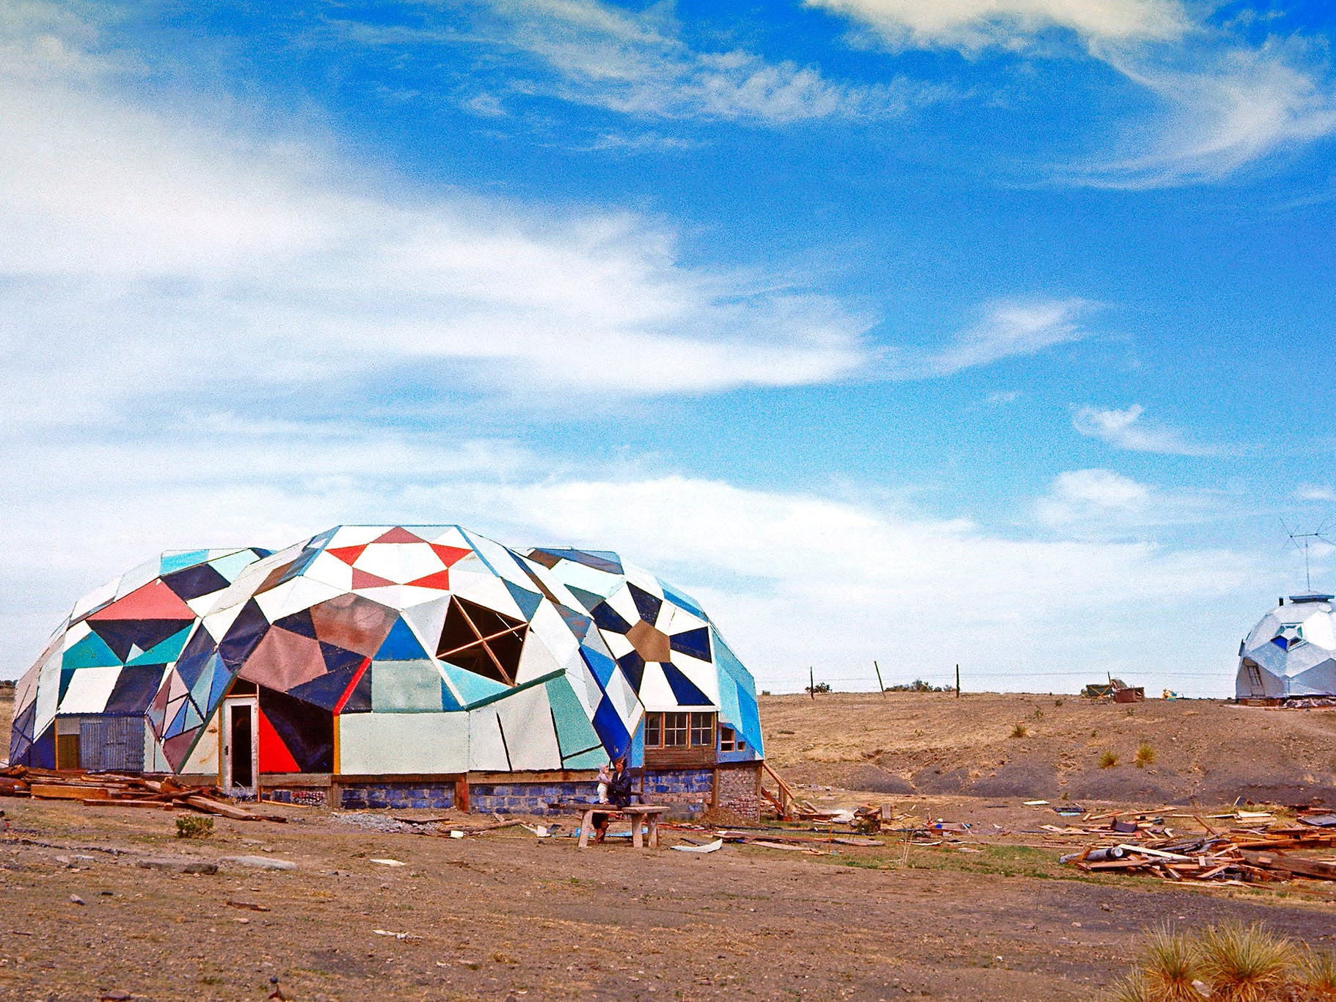
UTOPIAN COMMUNITIES

Slide 13
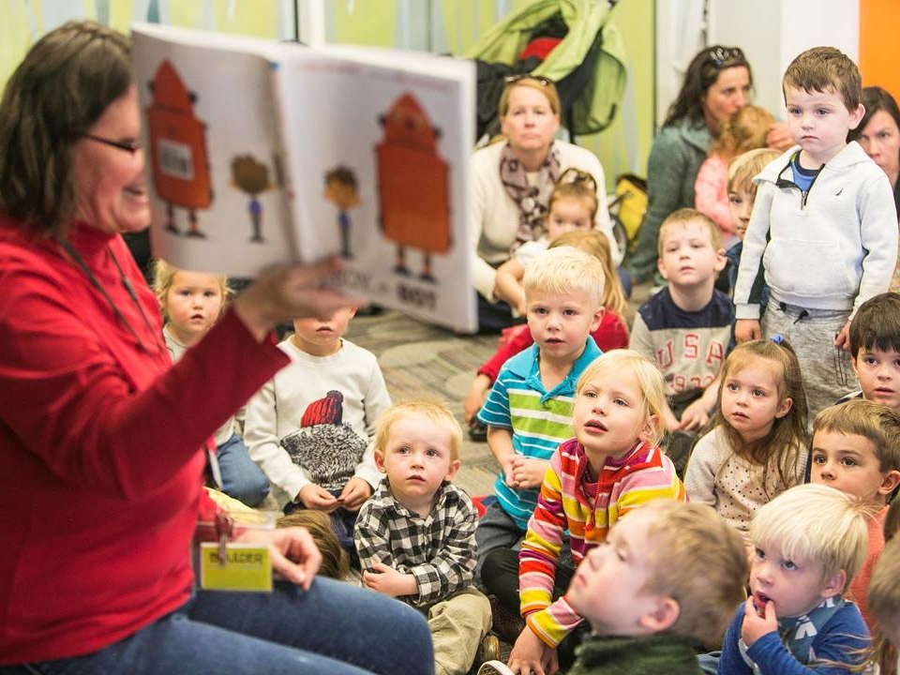
ENGAGED COMMUNITIES

Slide 14
QUOTES
QUIET
“I would like to have study space that is quiet and has good light.”
- Kathleen
OUTDOORS
“It is important that it is colorful, has lots of trees, plants, and grass. And a lot of flowers, lunch area, benches, and a lot of fun!”
- Eleanor
MAKERSPACE
“I would love to see a [makerspace]. This is a place where artists can work, and where people can learn how to make their invention come to reality.”
- Calder
GARDEN
“I would love to see a library site that is well integrated into the existing landscape and that allows for the inclusion of an adjacent community garden.”
- Sidney

Slide 15
KIDS
“The kids will continue to take out books. They would stay longer if there was more opportunity for physical activity. I (parent) would come more and stay longer.”
- Schwartz Family
PLAYGROUND
“It would be great for our children to have an outdoor space […] for kids to play in.”
- Christine
COMMUNITY
“The library needs an indoor space for communities to meet and host workshops. It needs to inspire the community.”
- Alex

Slide 16
LIBRARY VISION CONCEPT

Slide 18
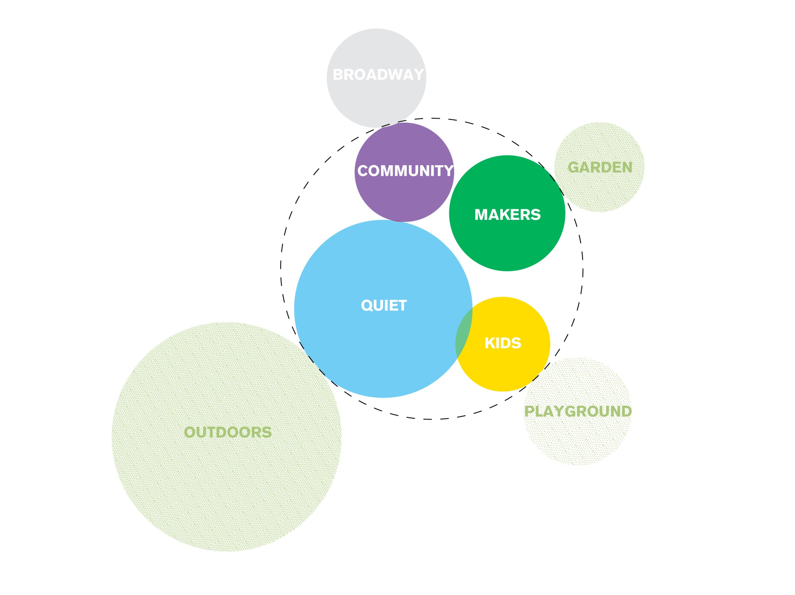
PROGRAM ADJACENCIES

Slide 19
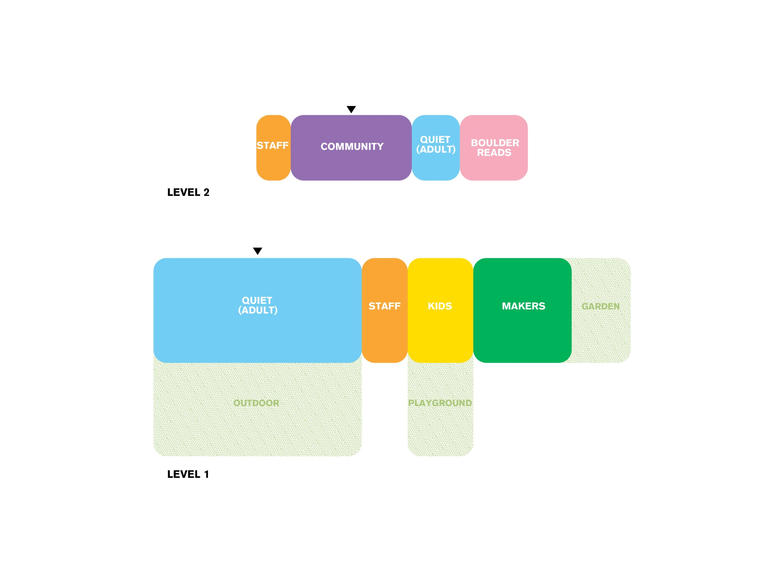
FIRST + SECOND

Slide 20
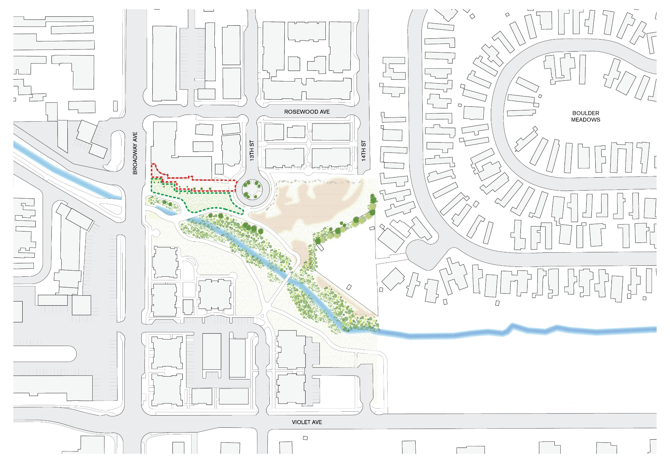
SITE LOCATION

Slide 21
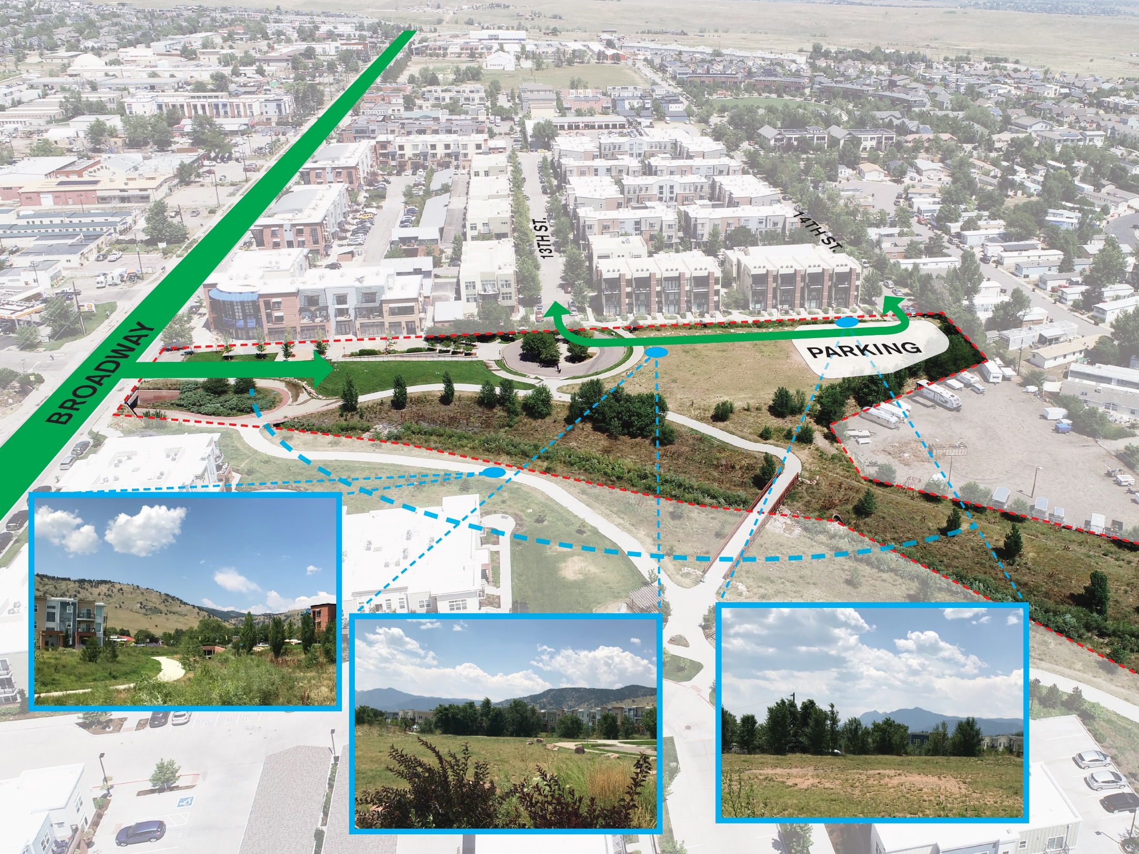
SITE ANALYSIS

Slide 22
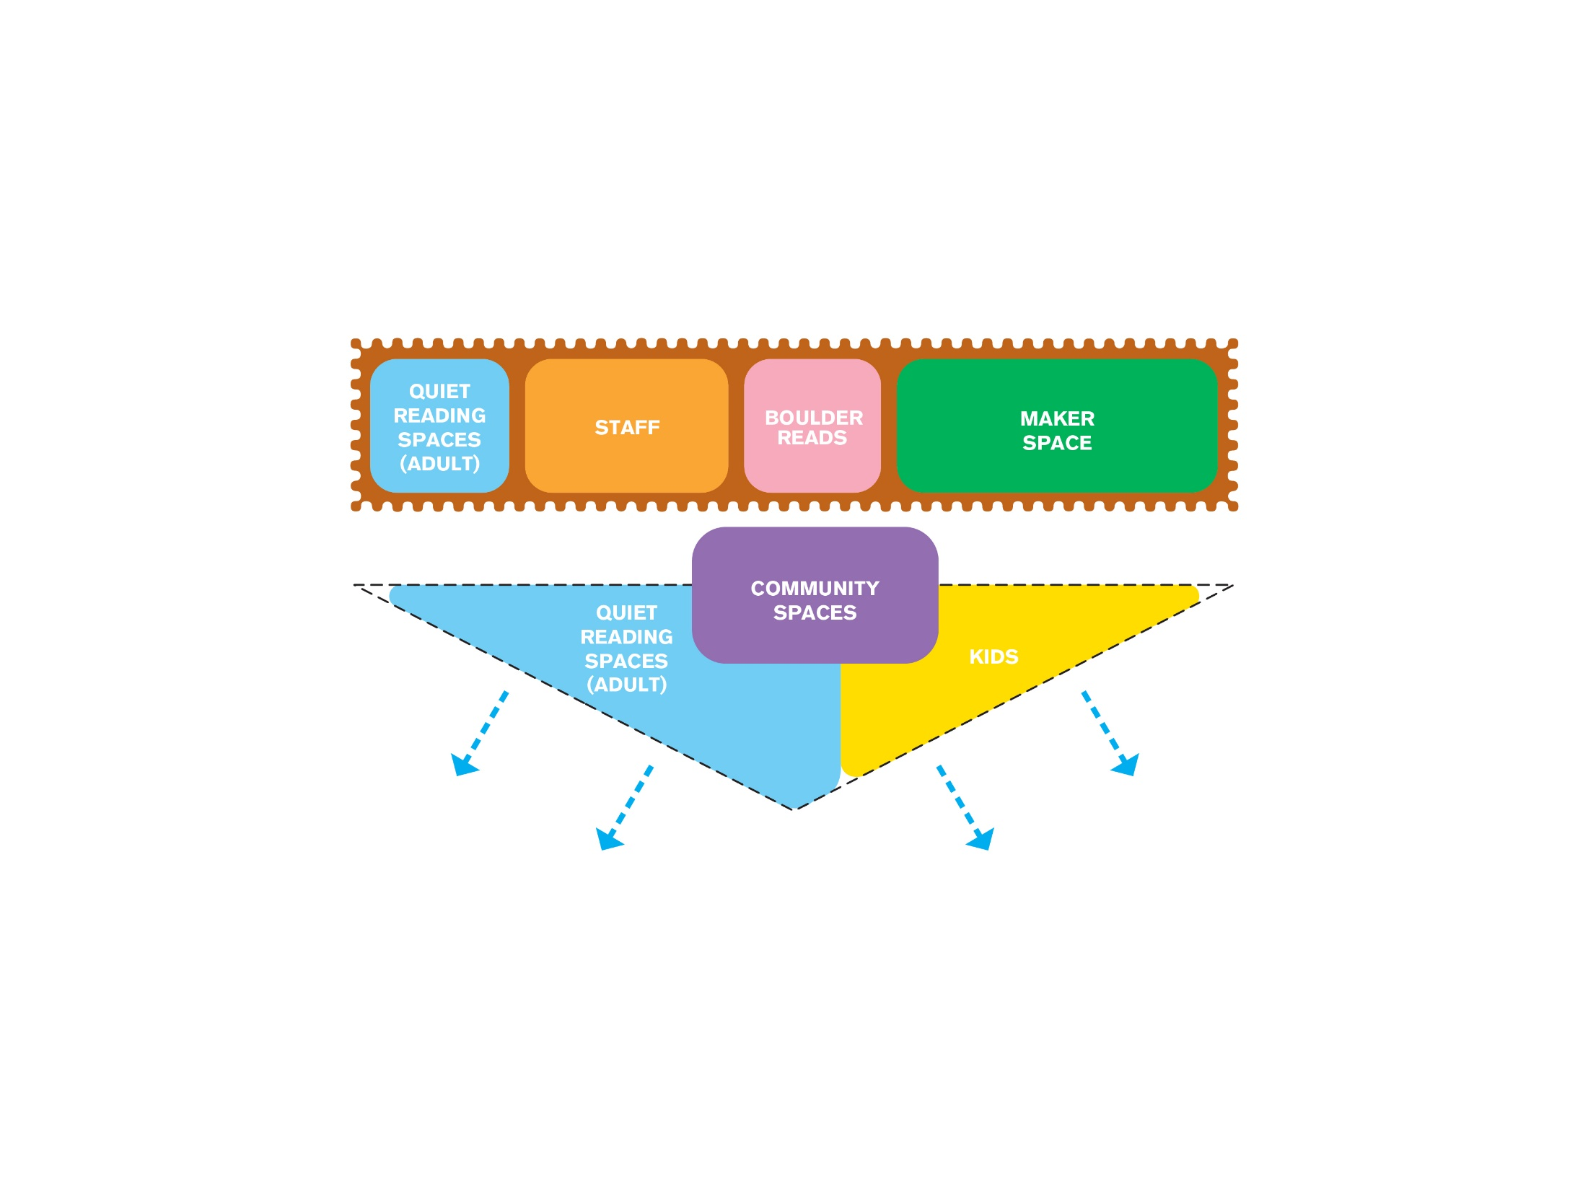
CONSTRAST + DUALITIES

Slide 23
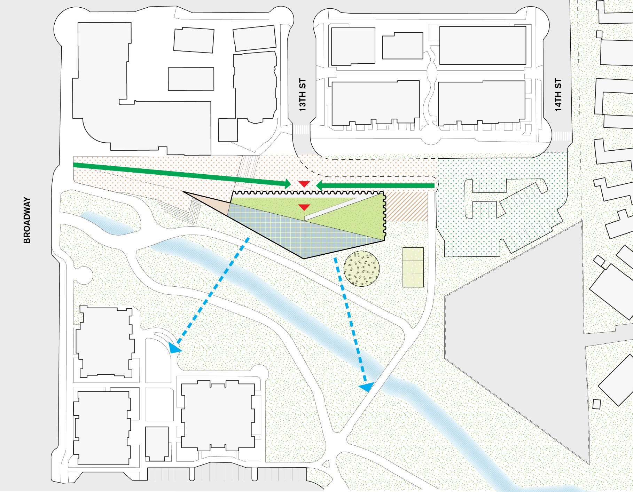
SITE PLAN

Slide 24
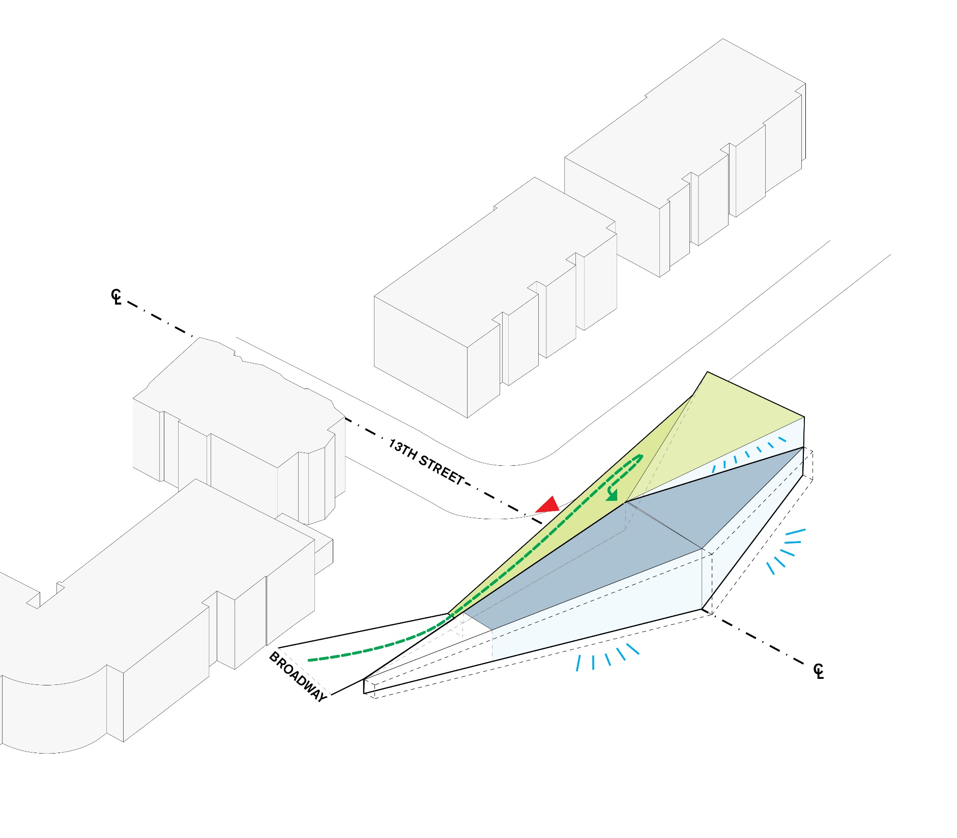
TOPOGRAPHY

Slide 25
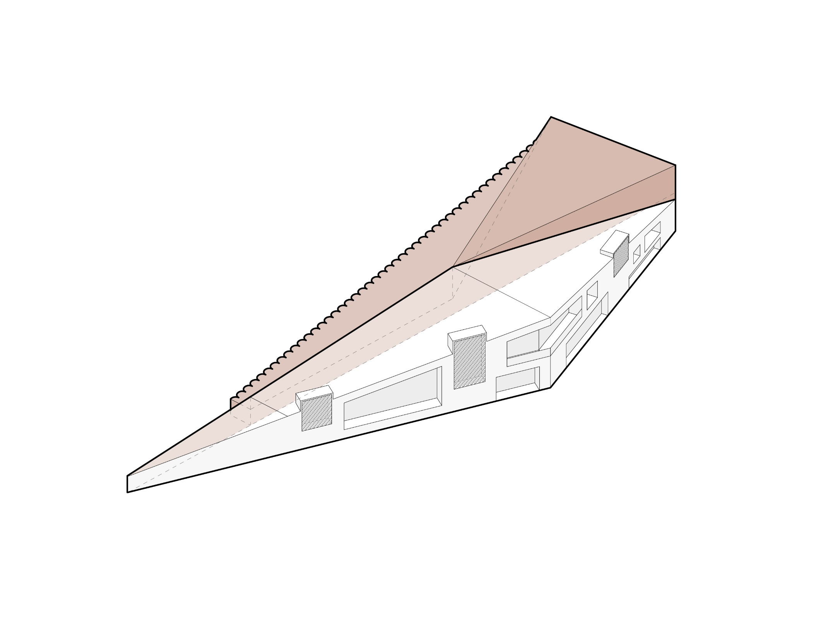
“ MORE CLOSED” VS “MORE OPEN”

Slide 26
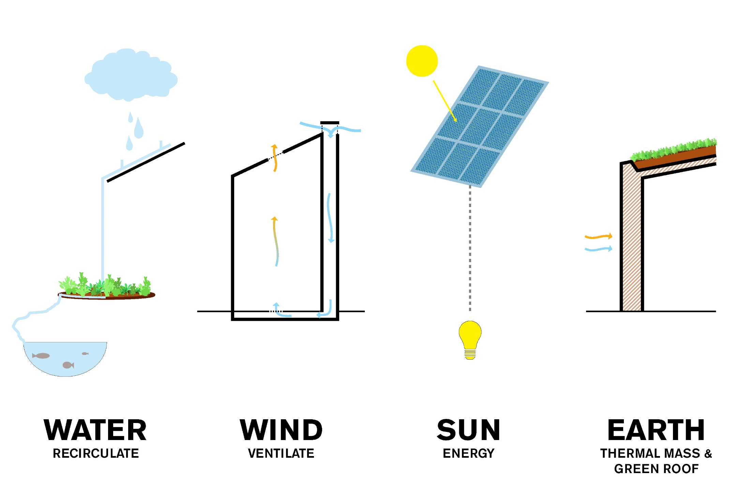
ICONIC SYSTEMS

Slide 27
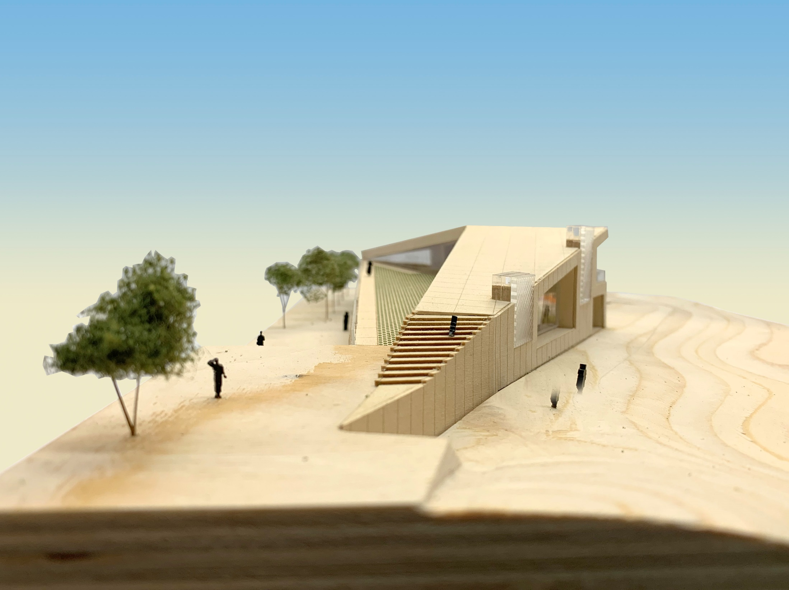
ICONIC PRESENCE - BROADWAY

Slide 28
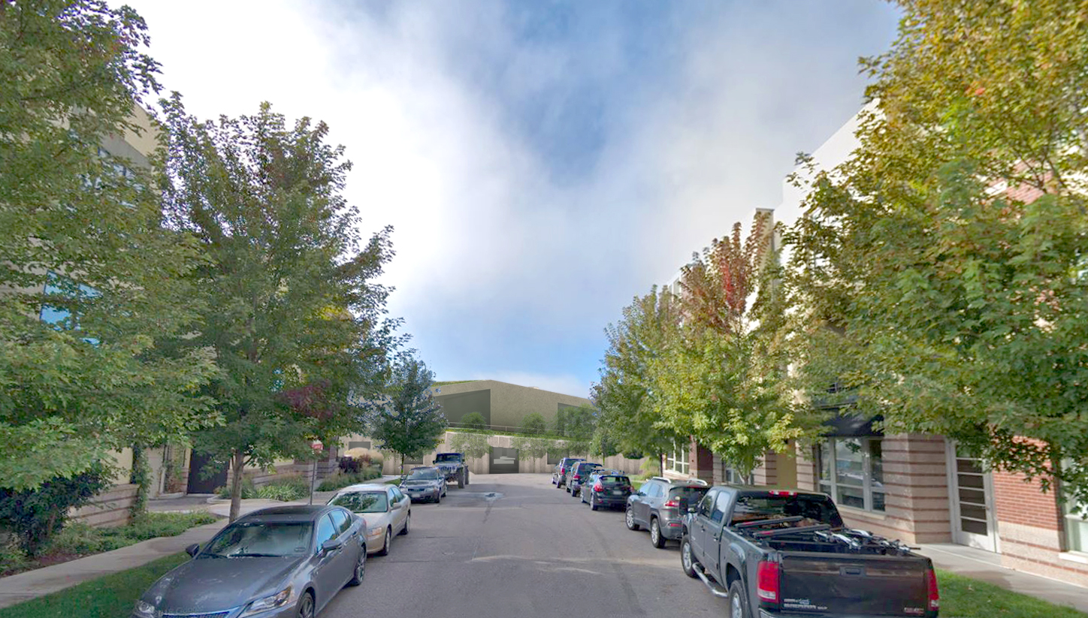
ICONIC PRESENCE – 13TH STREET

Slide 29
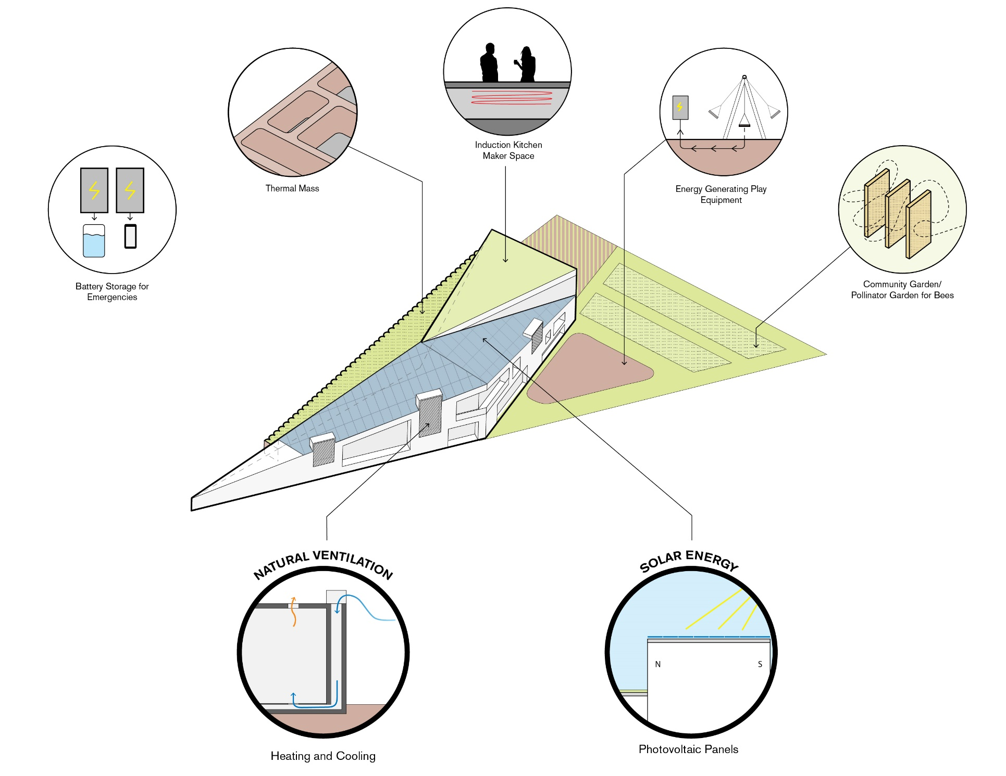
SUSTAINABLE SYSTEMS

Slide 30
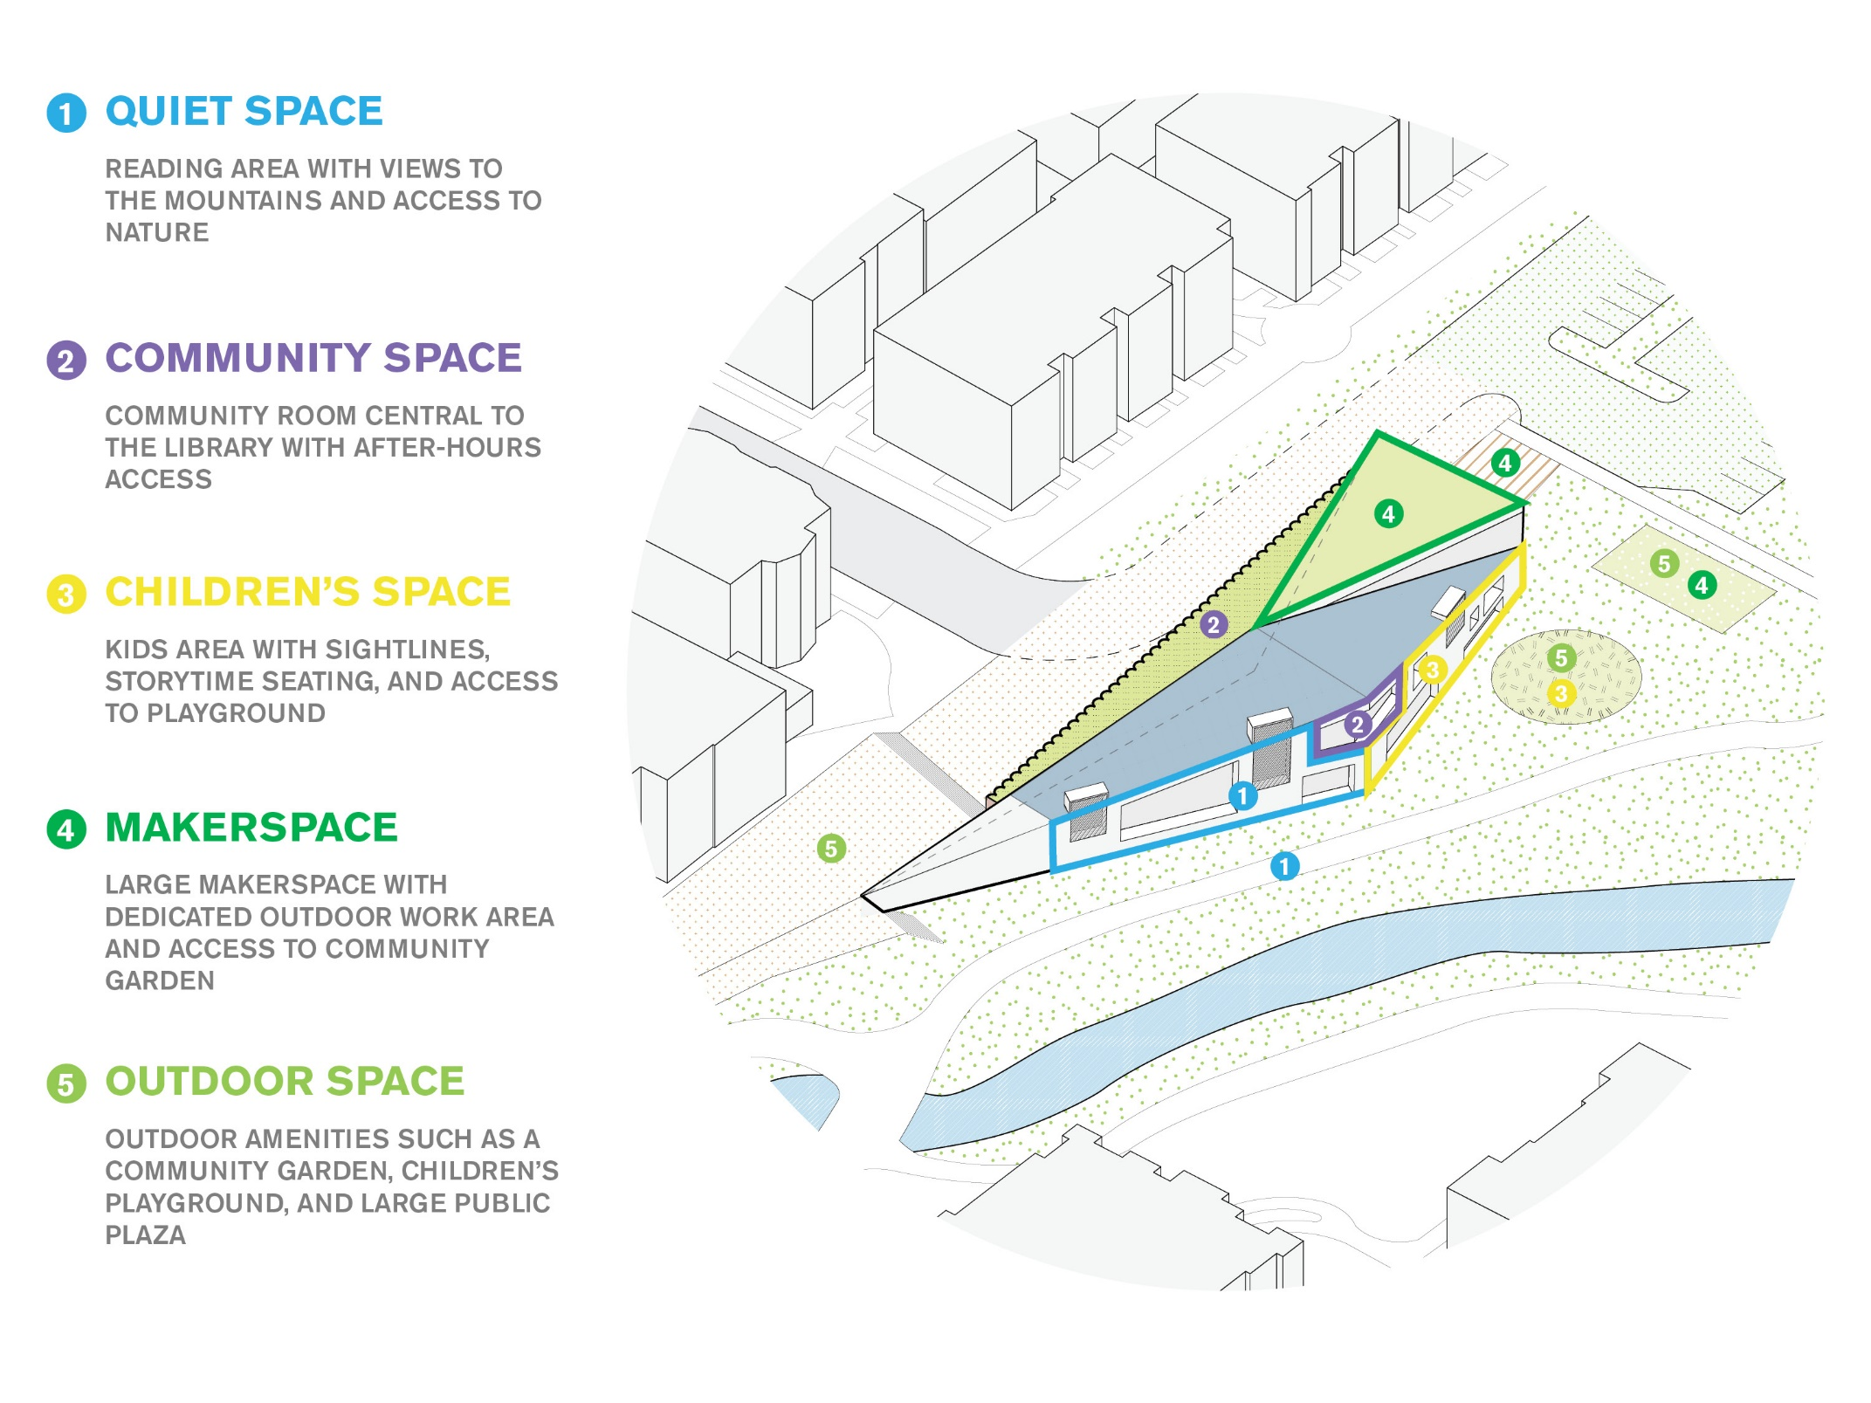
COMMUNITY RESPONSE DESIGN

Slide 31
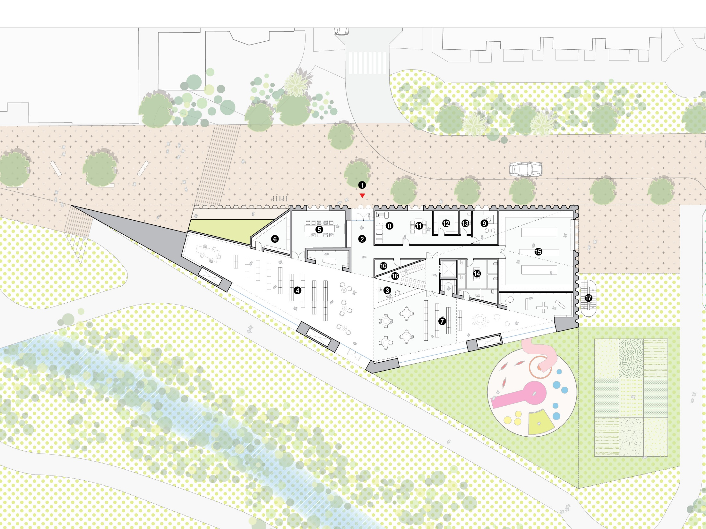
PLAN 1

Slide 32
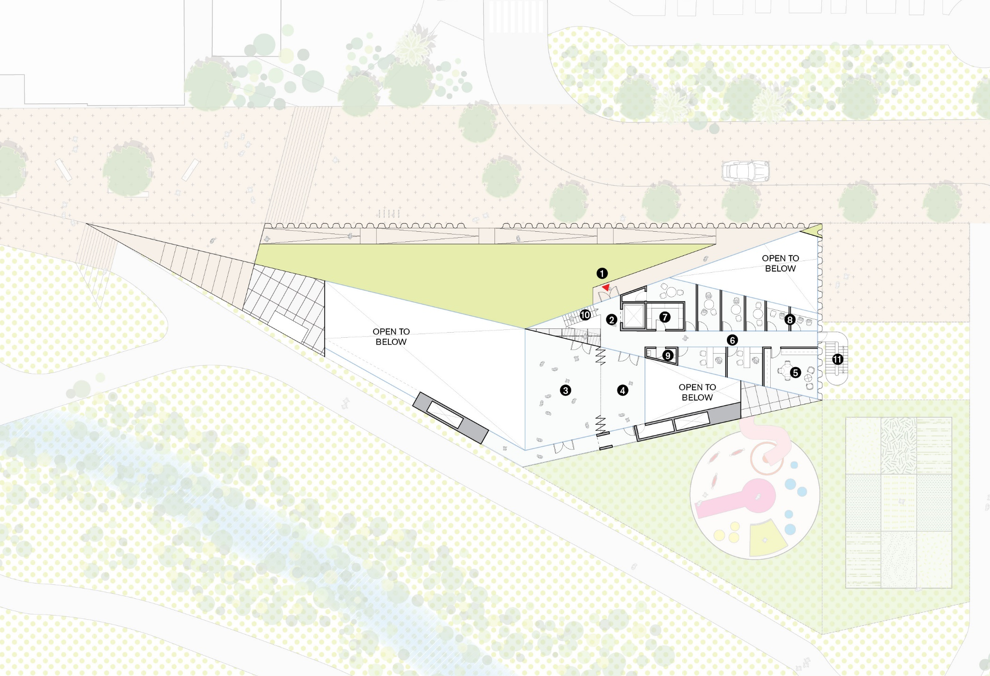
PLAN 2

Slide 33
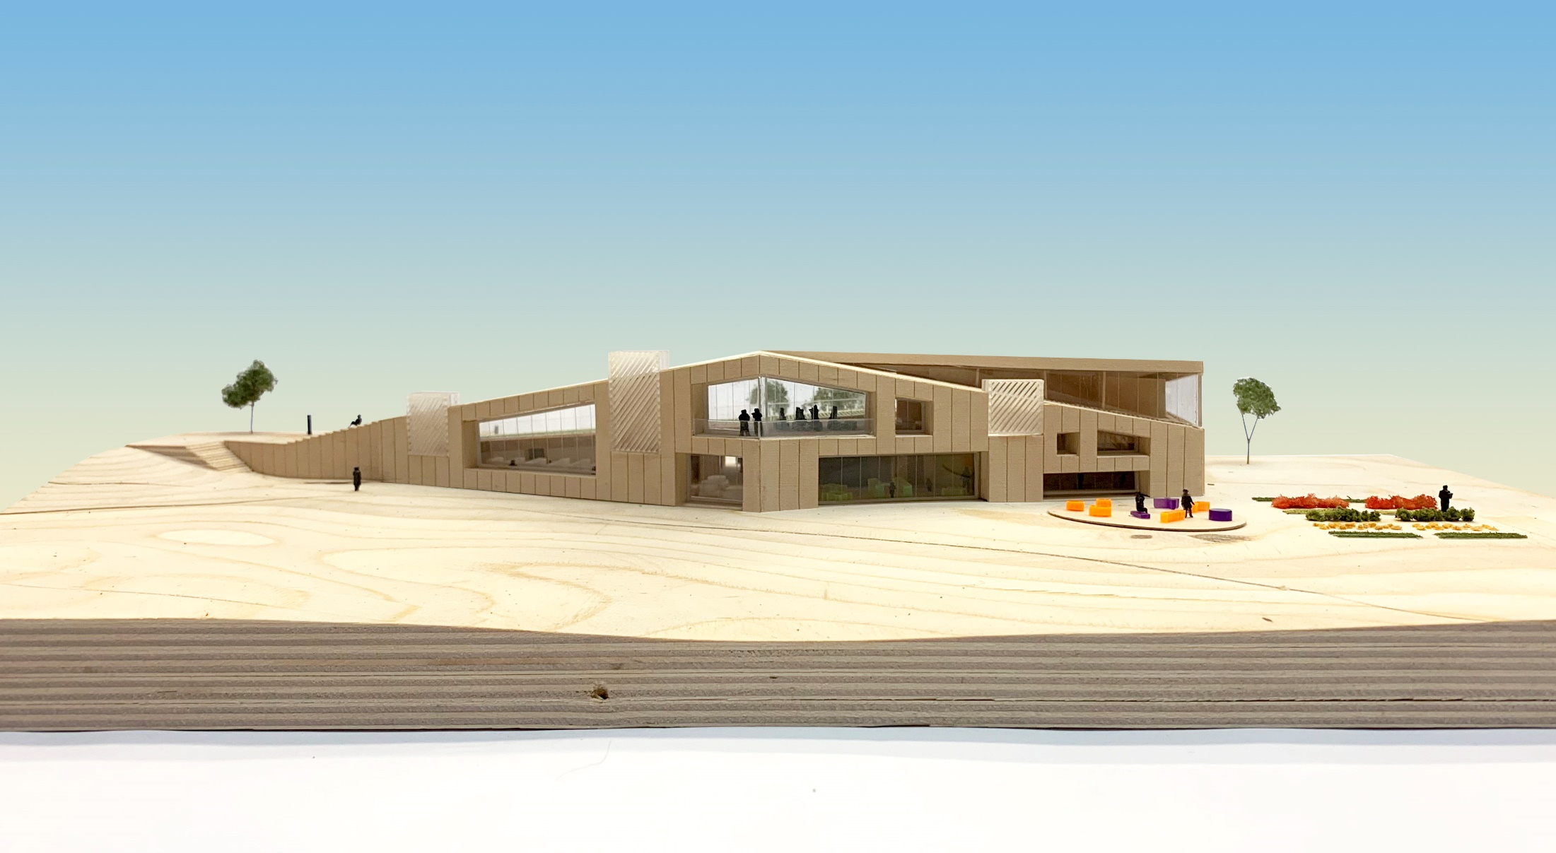
VIEW FROM CREEK

Slide 34
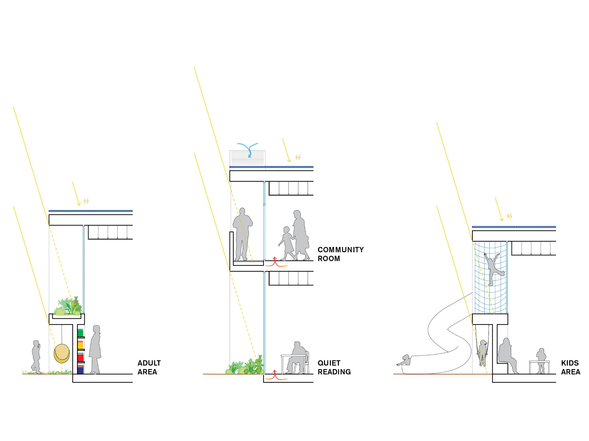
FAÇADE SECTION IDEAS

Slide 35
NORTH BOULDER LIBRARY DESIGN TEAM:
ARCHITECT WORKac, New York
LOCAL ARCHITECT STUDIOS, Boulder
CIVIL ENGINEERS JVA, Boulder
MEP ENGINEERS &
SUSTAINABILITY, ENERGY MAZZETTI, Denver
STRUCTURAL ENGINEERS &
FAÇADE , ENVELOPE STUDIO NYL, Boulder
LANDSCAPE JB FIELDWORKS, Boulder
LIGHTING TILLOTSON, New York

Slide 36
FOCUS AREAS:
OUTDOOR SPACES
COMMUNITY ROOMS
MAKER SPACE
CHILDREN’S AREA

Slide 37
I. OUTDOOR SPACES

Slide 38
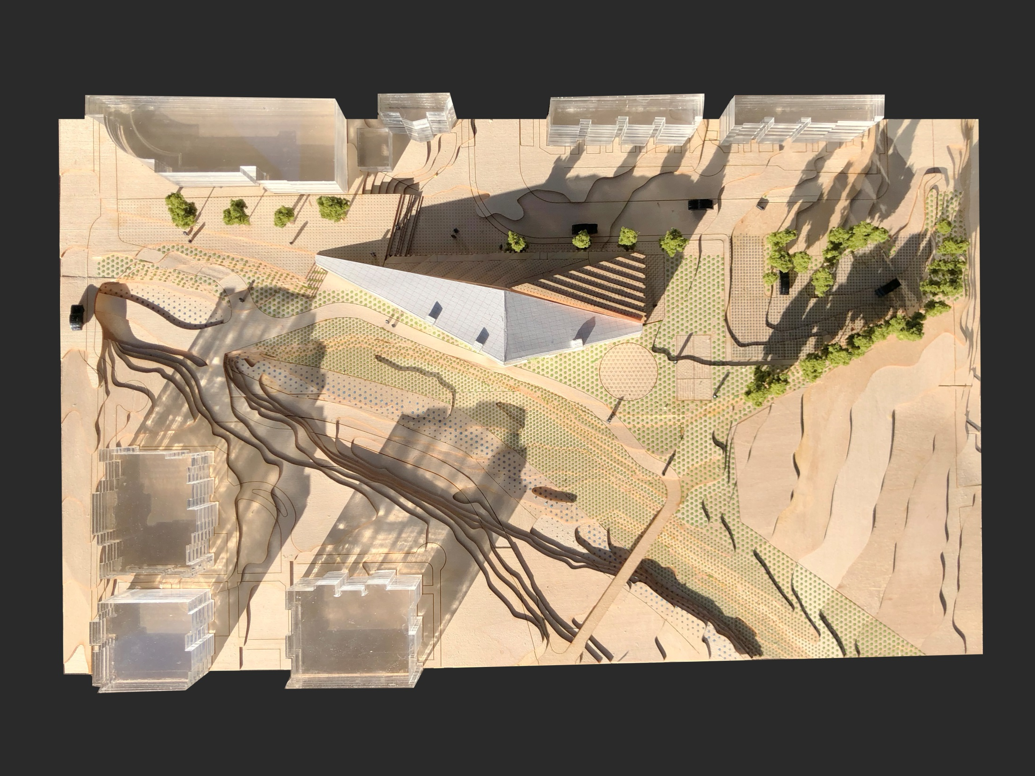
TOP VIEW

Slide 39
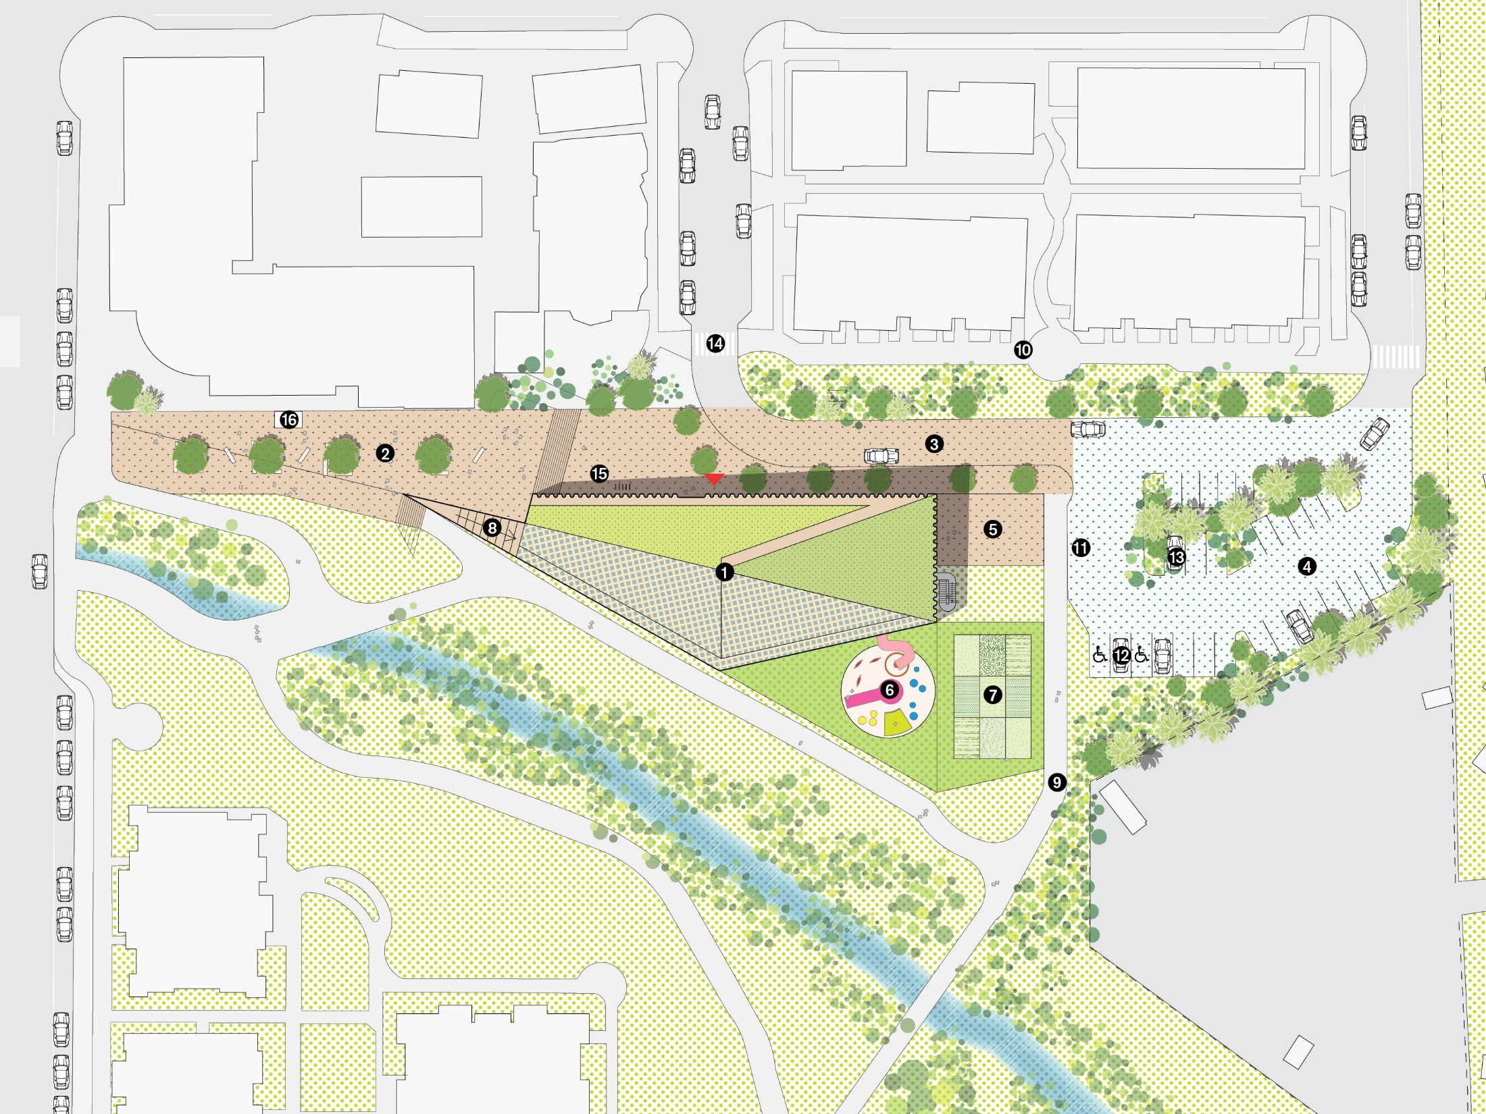
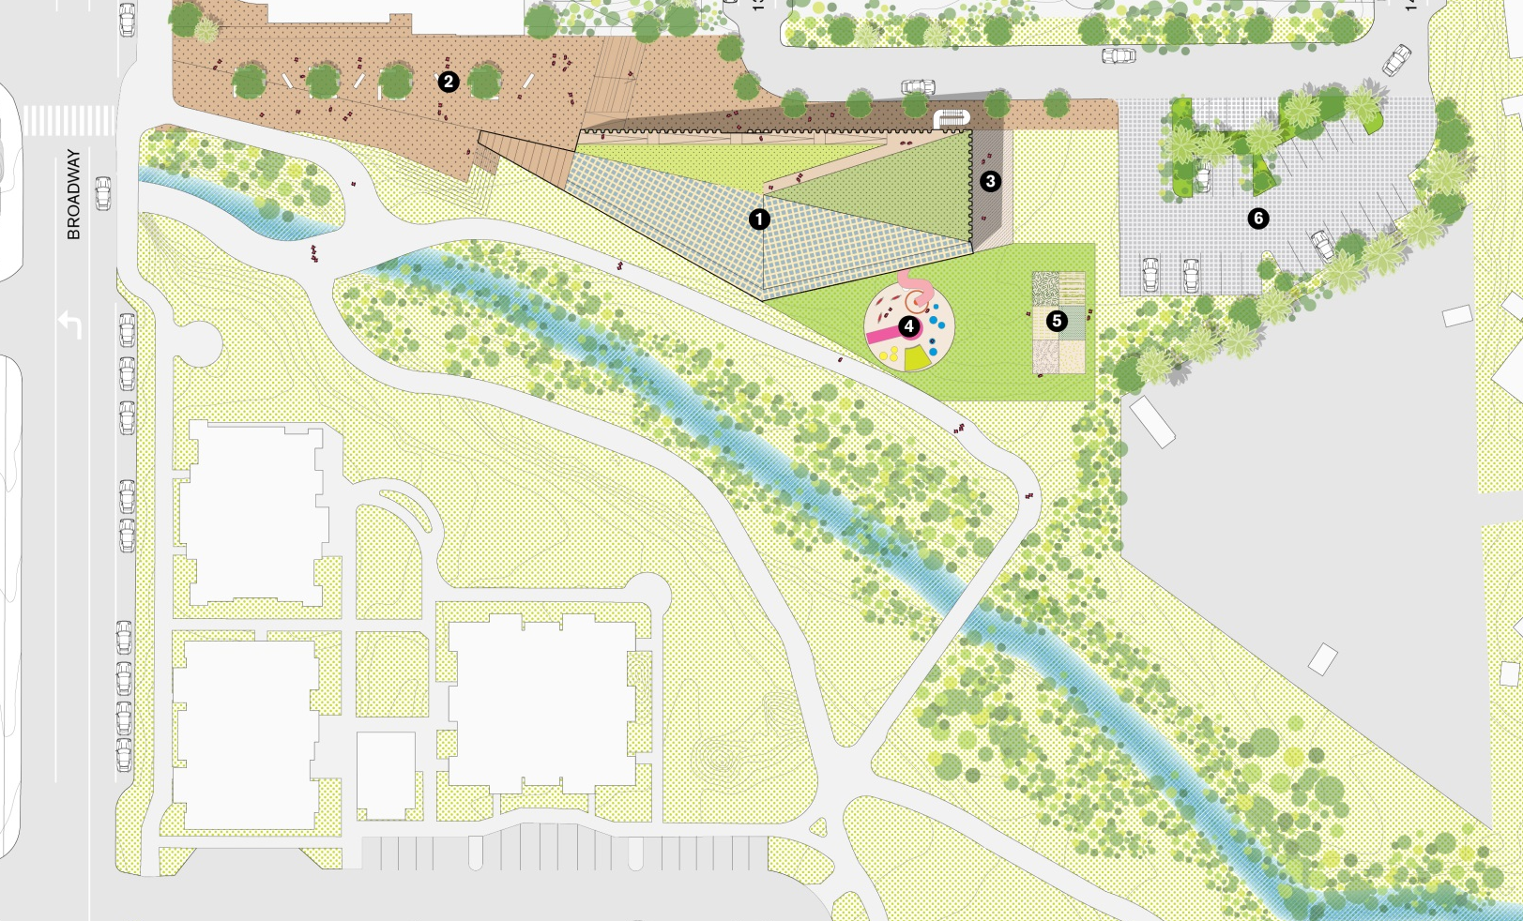
SITE PLAN

Slide 40
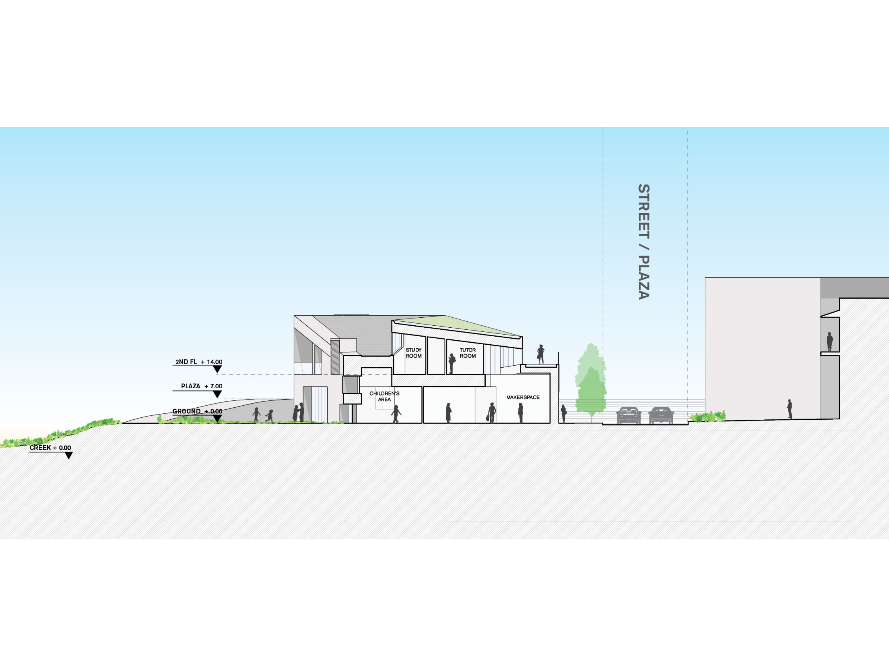
SECTION

Slide 41
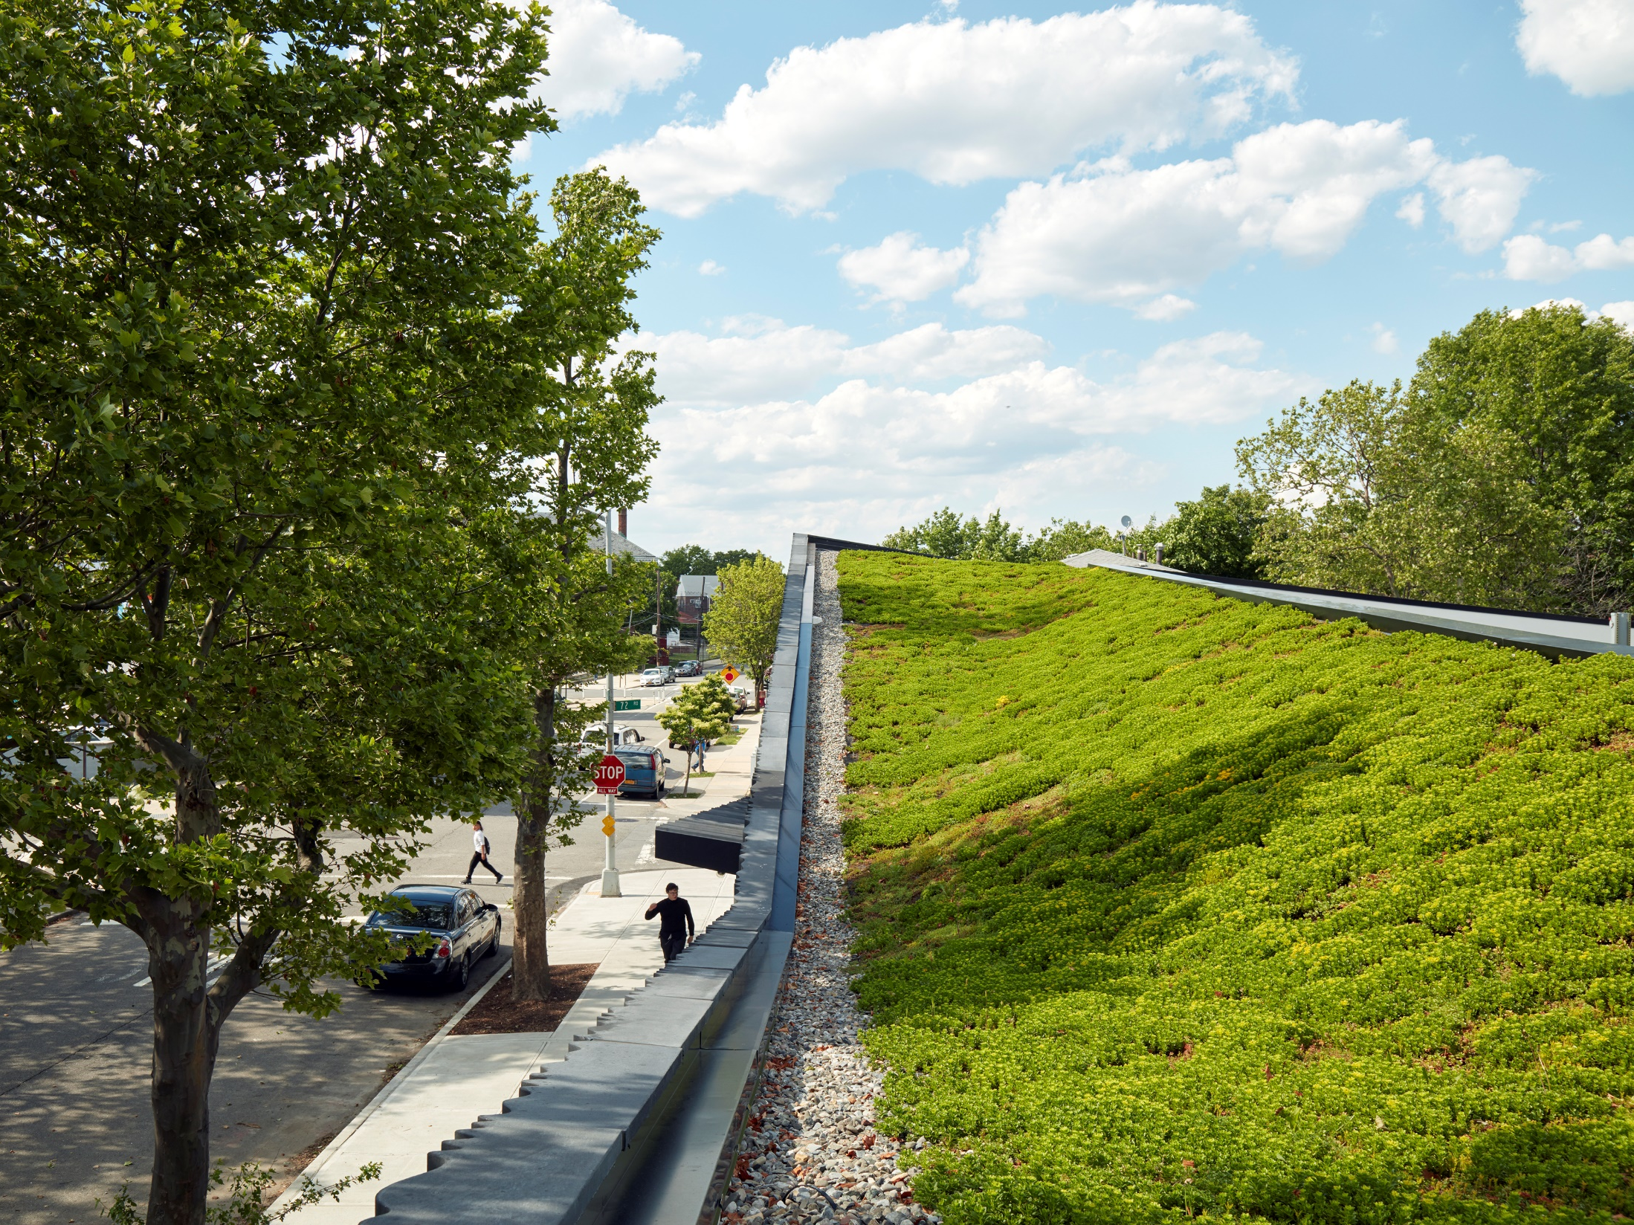

Slide 42
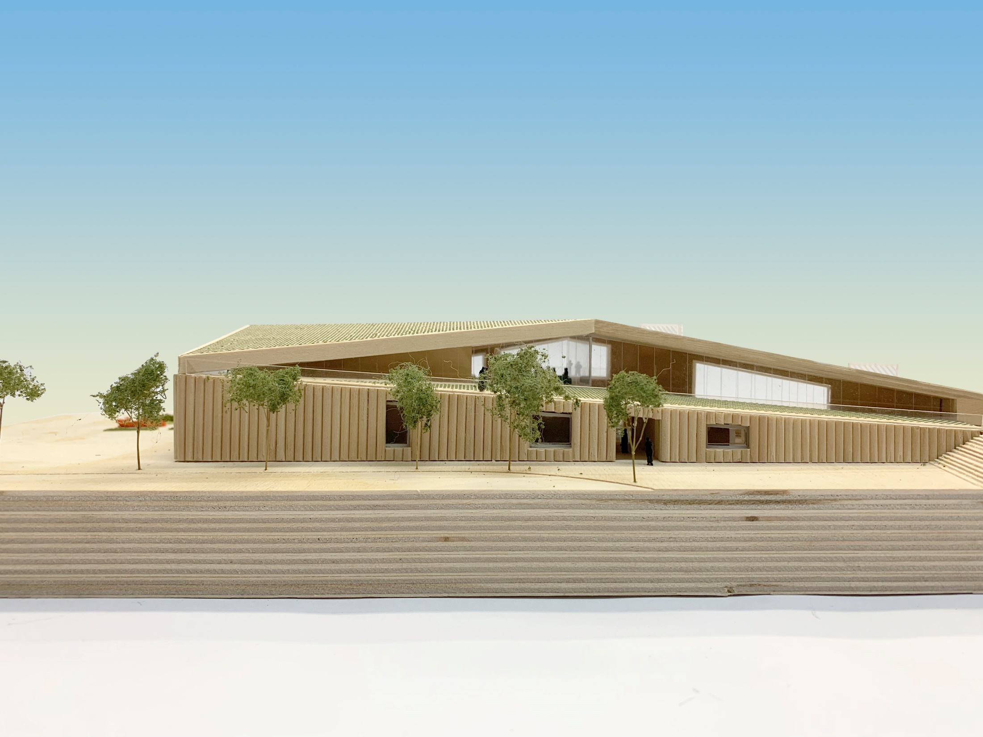

Slide 43
VOONDORF STREET & PLAZA

Slide 44
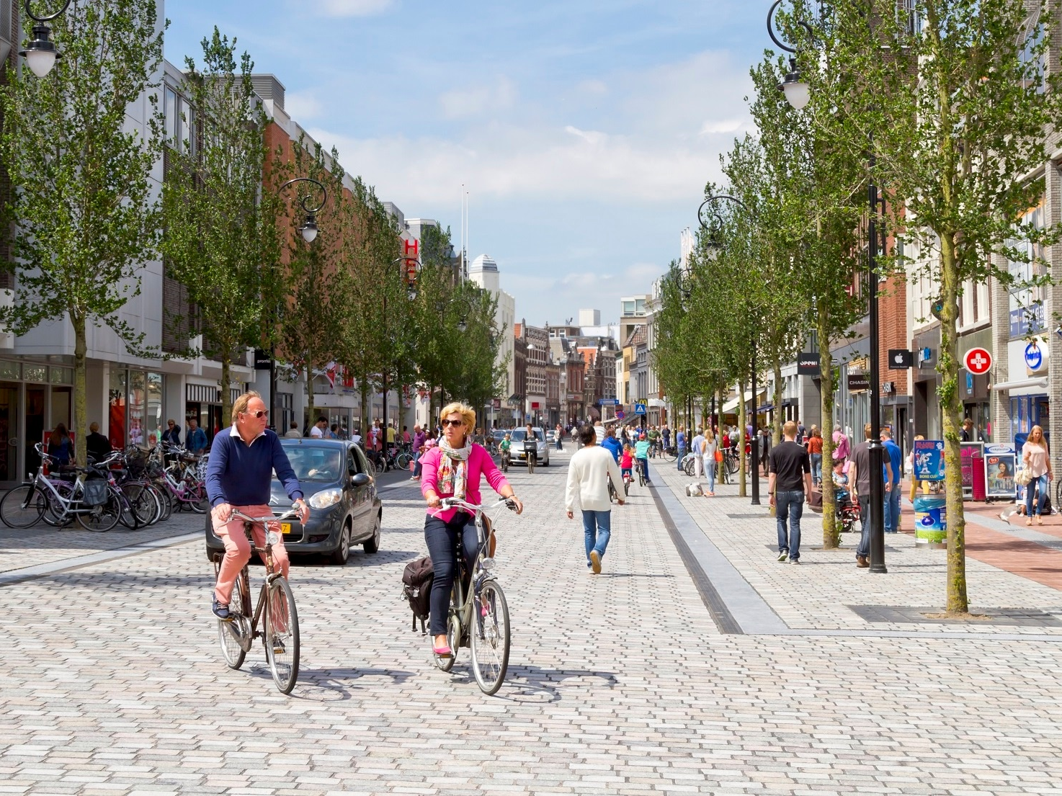

Slide 45
POROUS PARKING

Slide 46
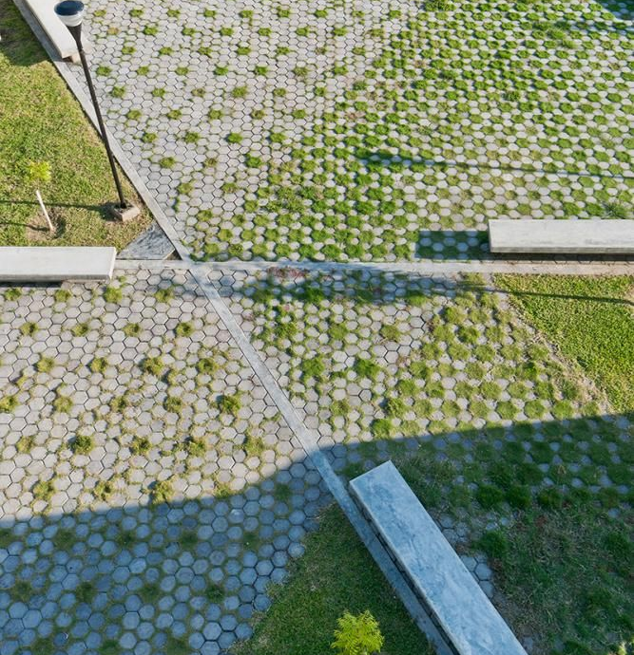

Slide 47
COMMUNITY GARDENS & PLAYGROUND

Slide 48
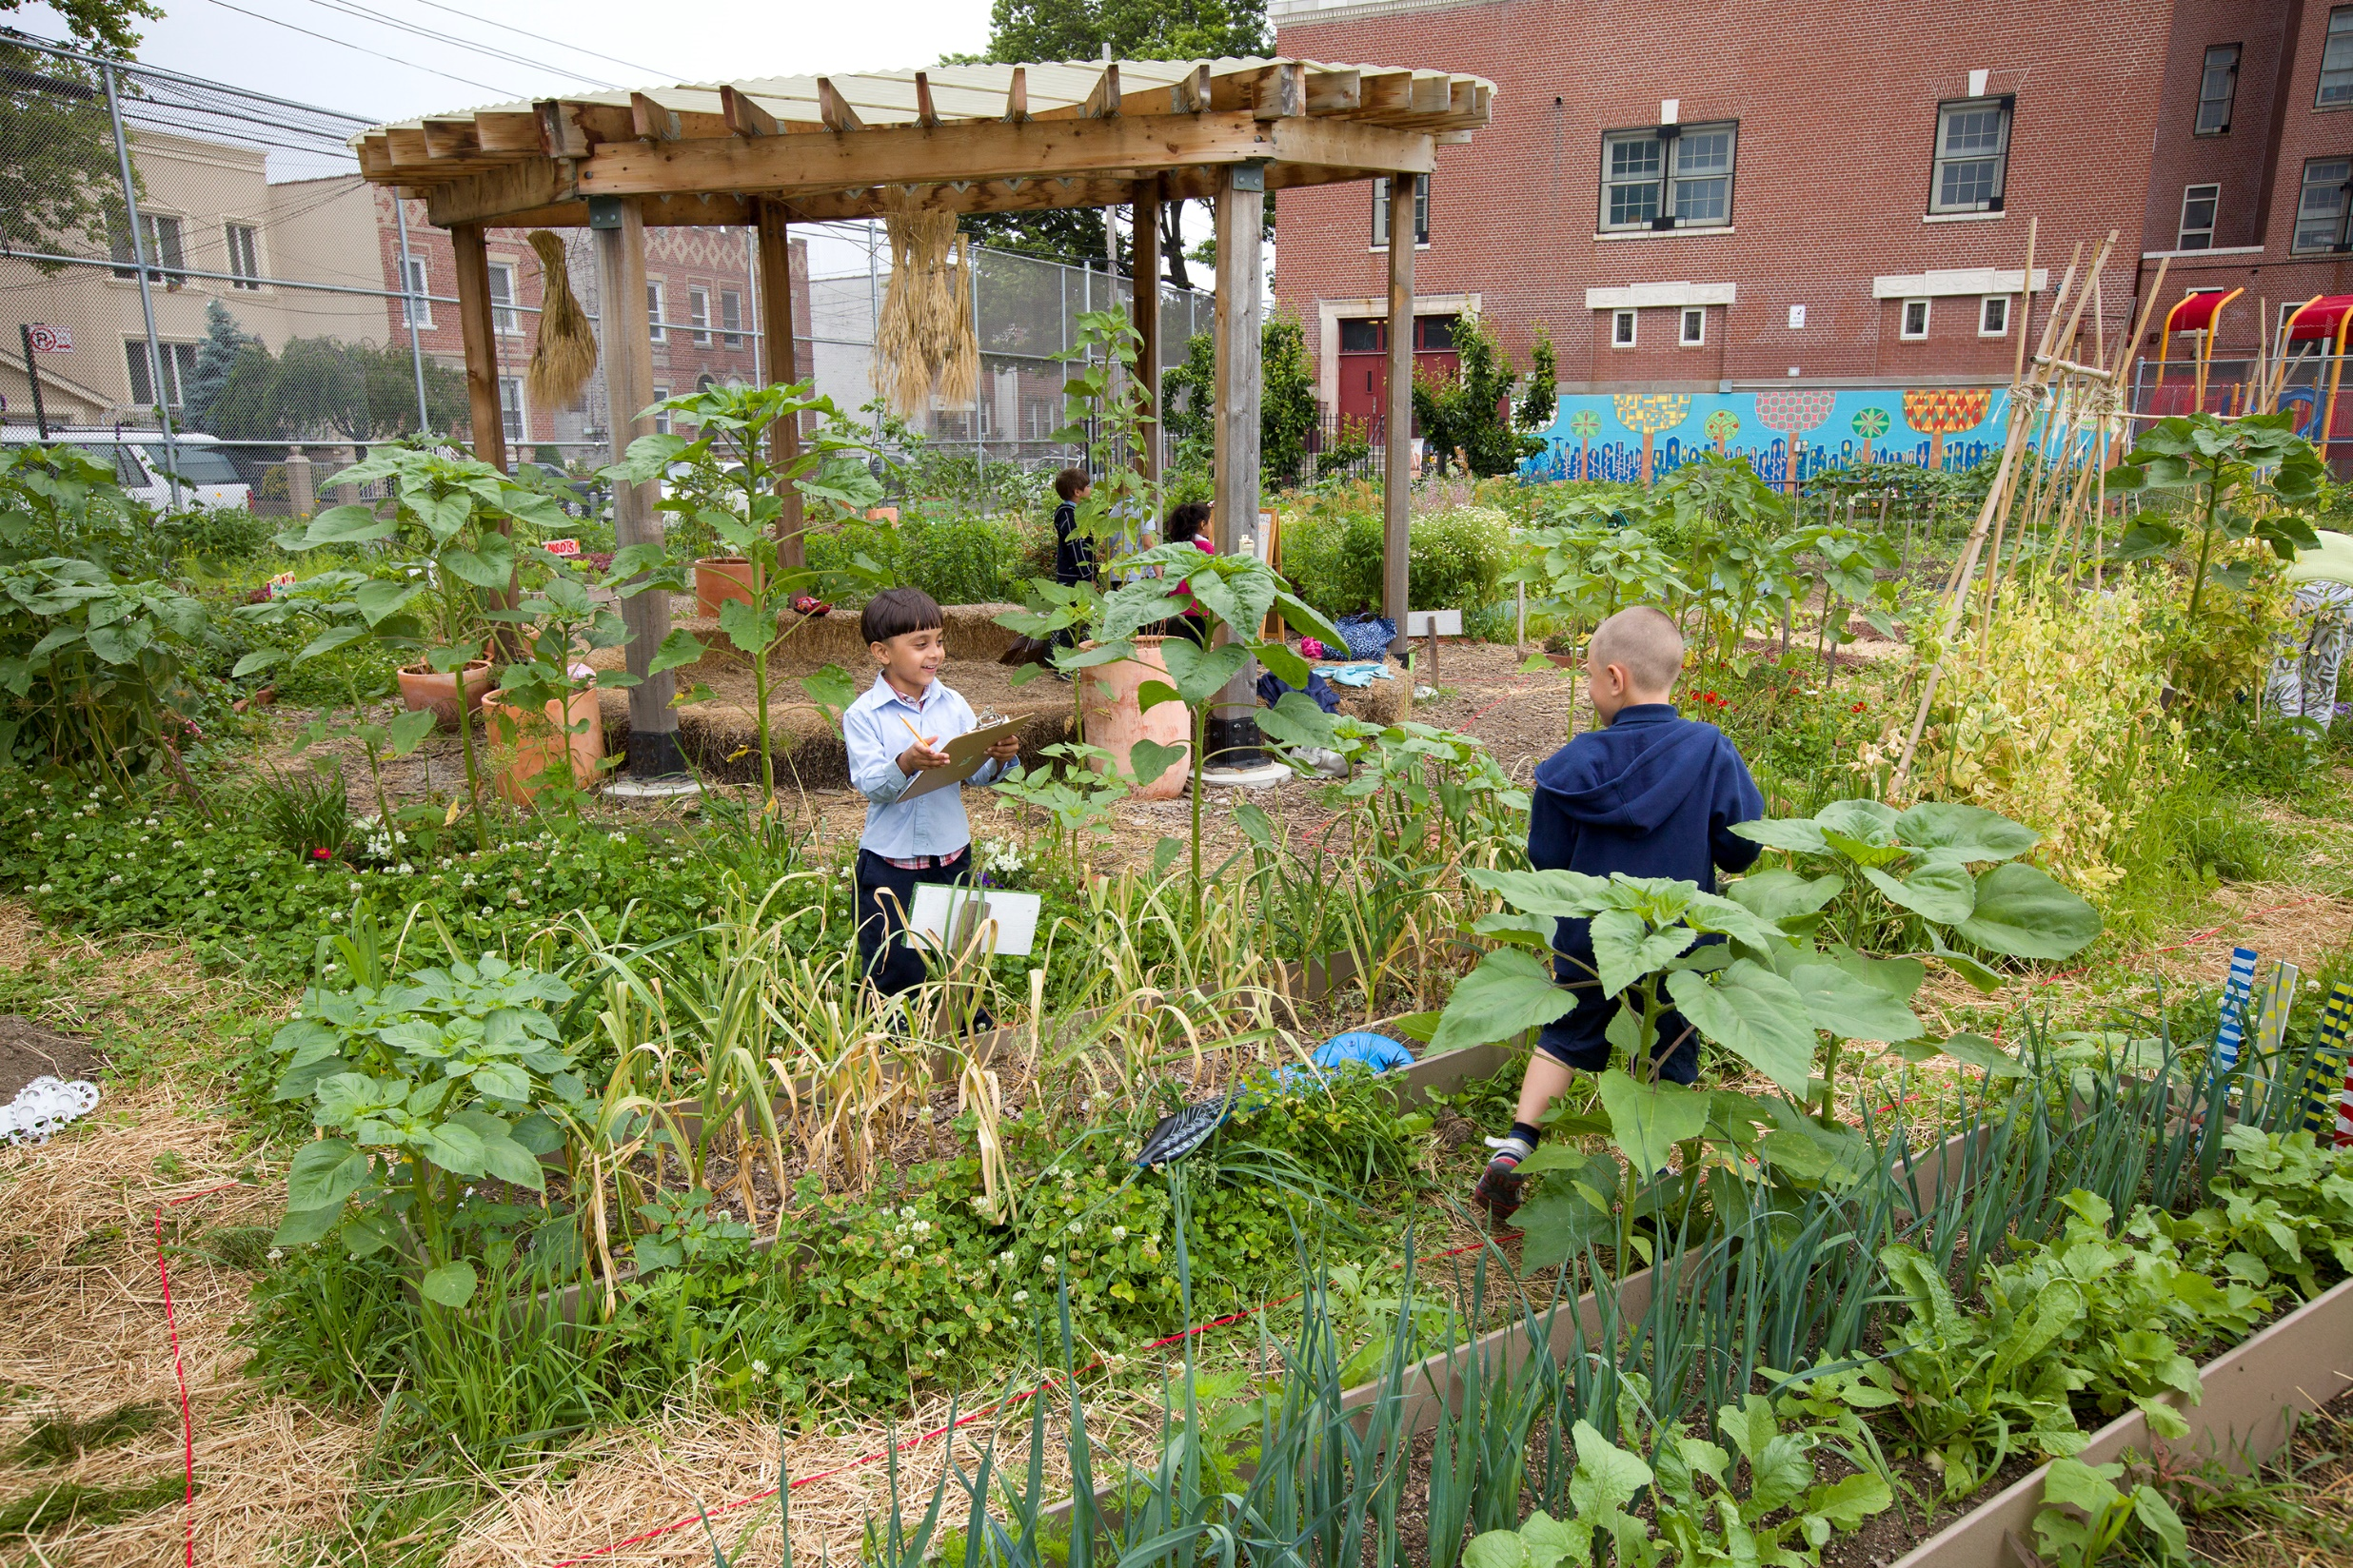

Slide 49
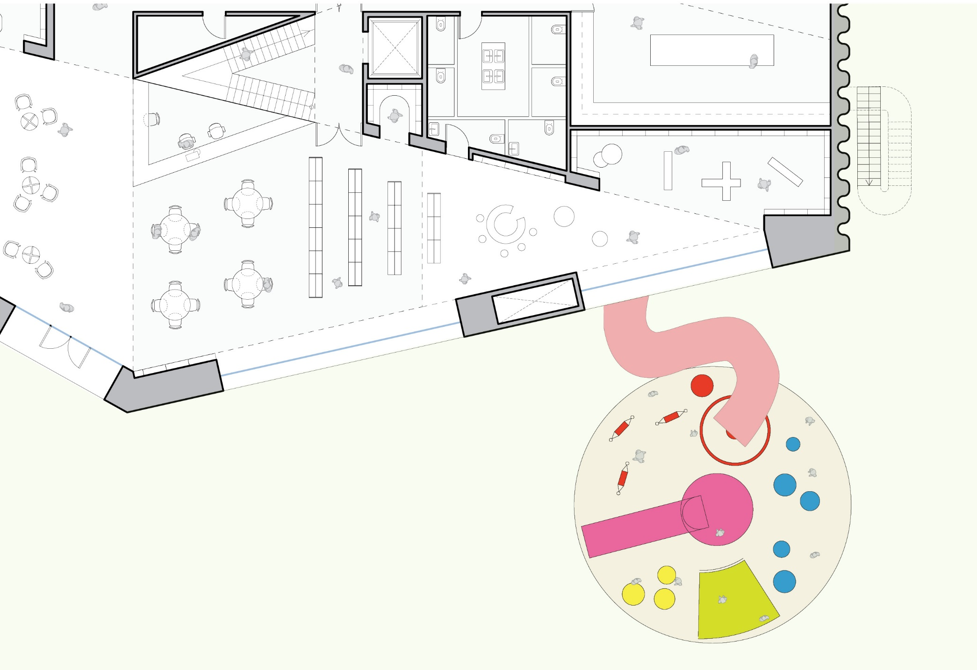
DETATCHED PLAYGROUND

Slide 50
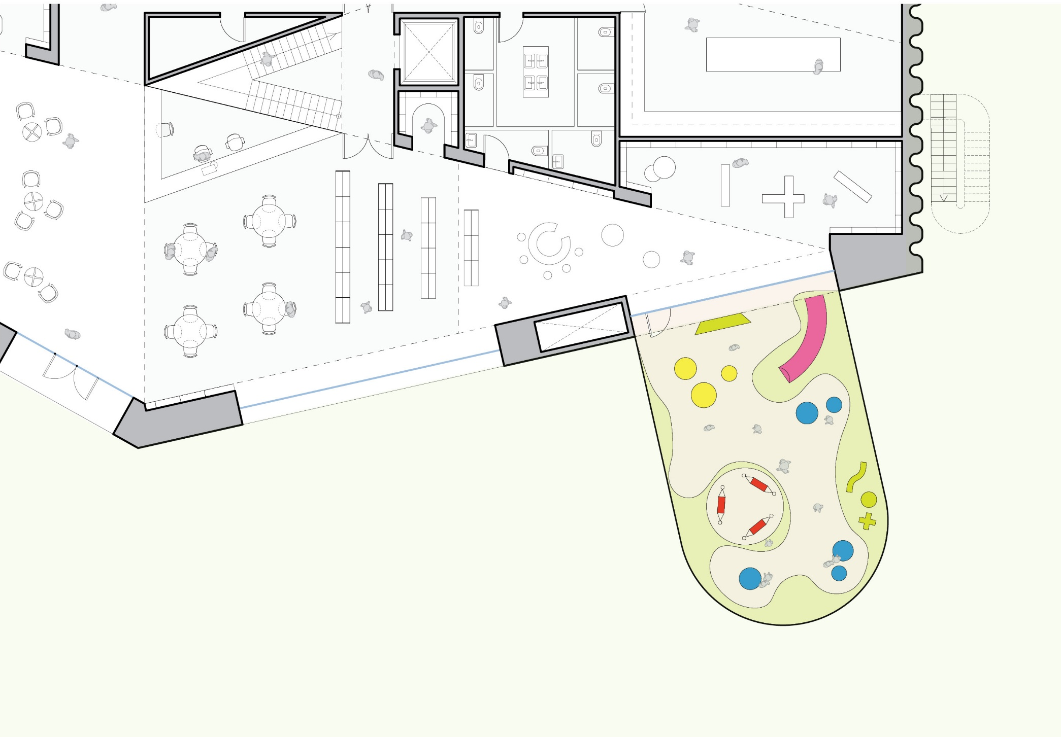
COURTYARD PLAYGROUND

Slide 51
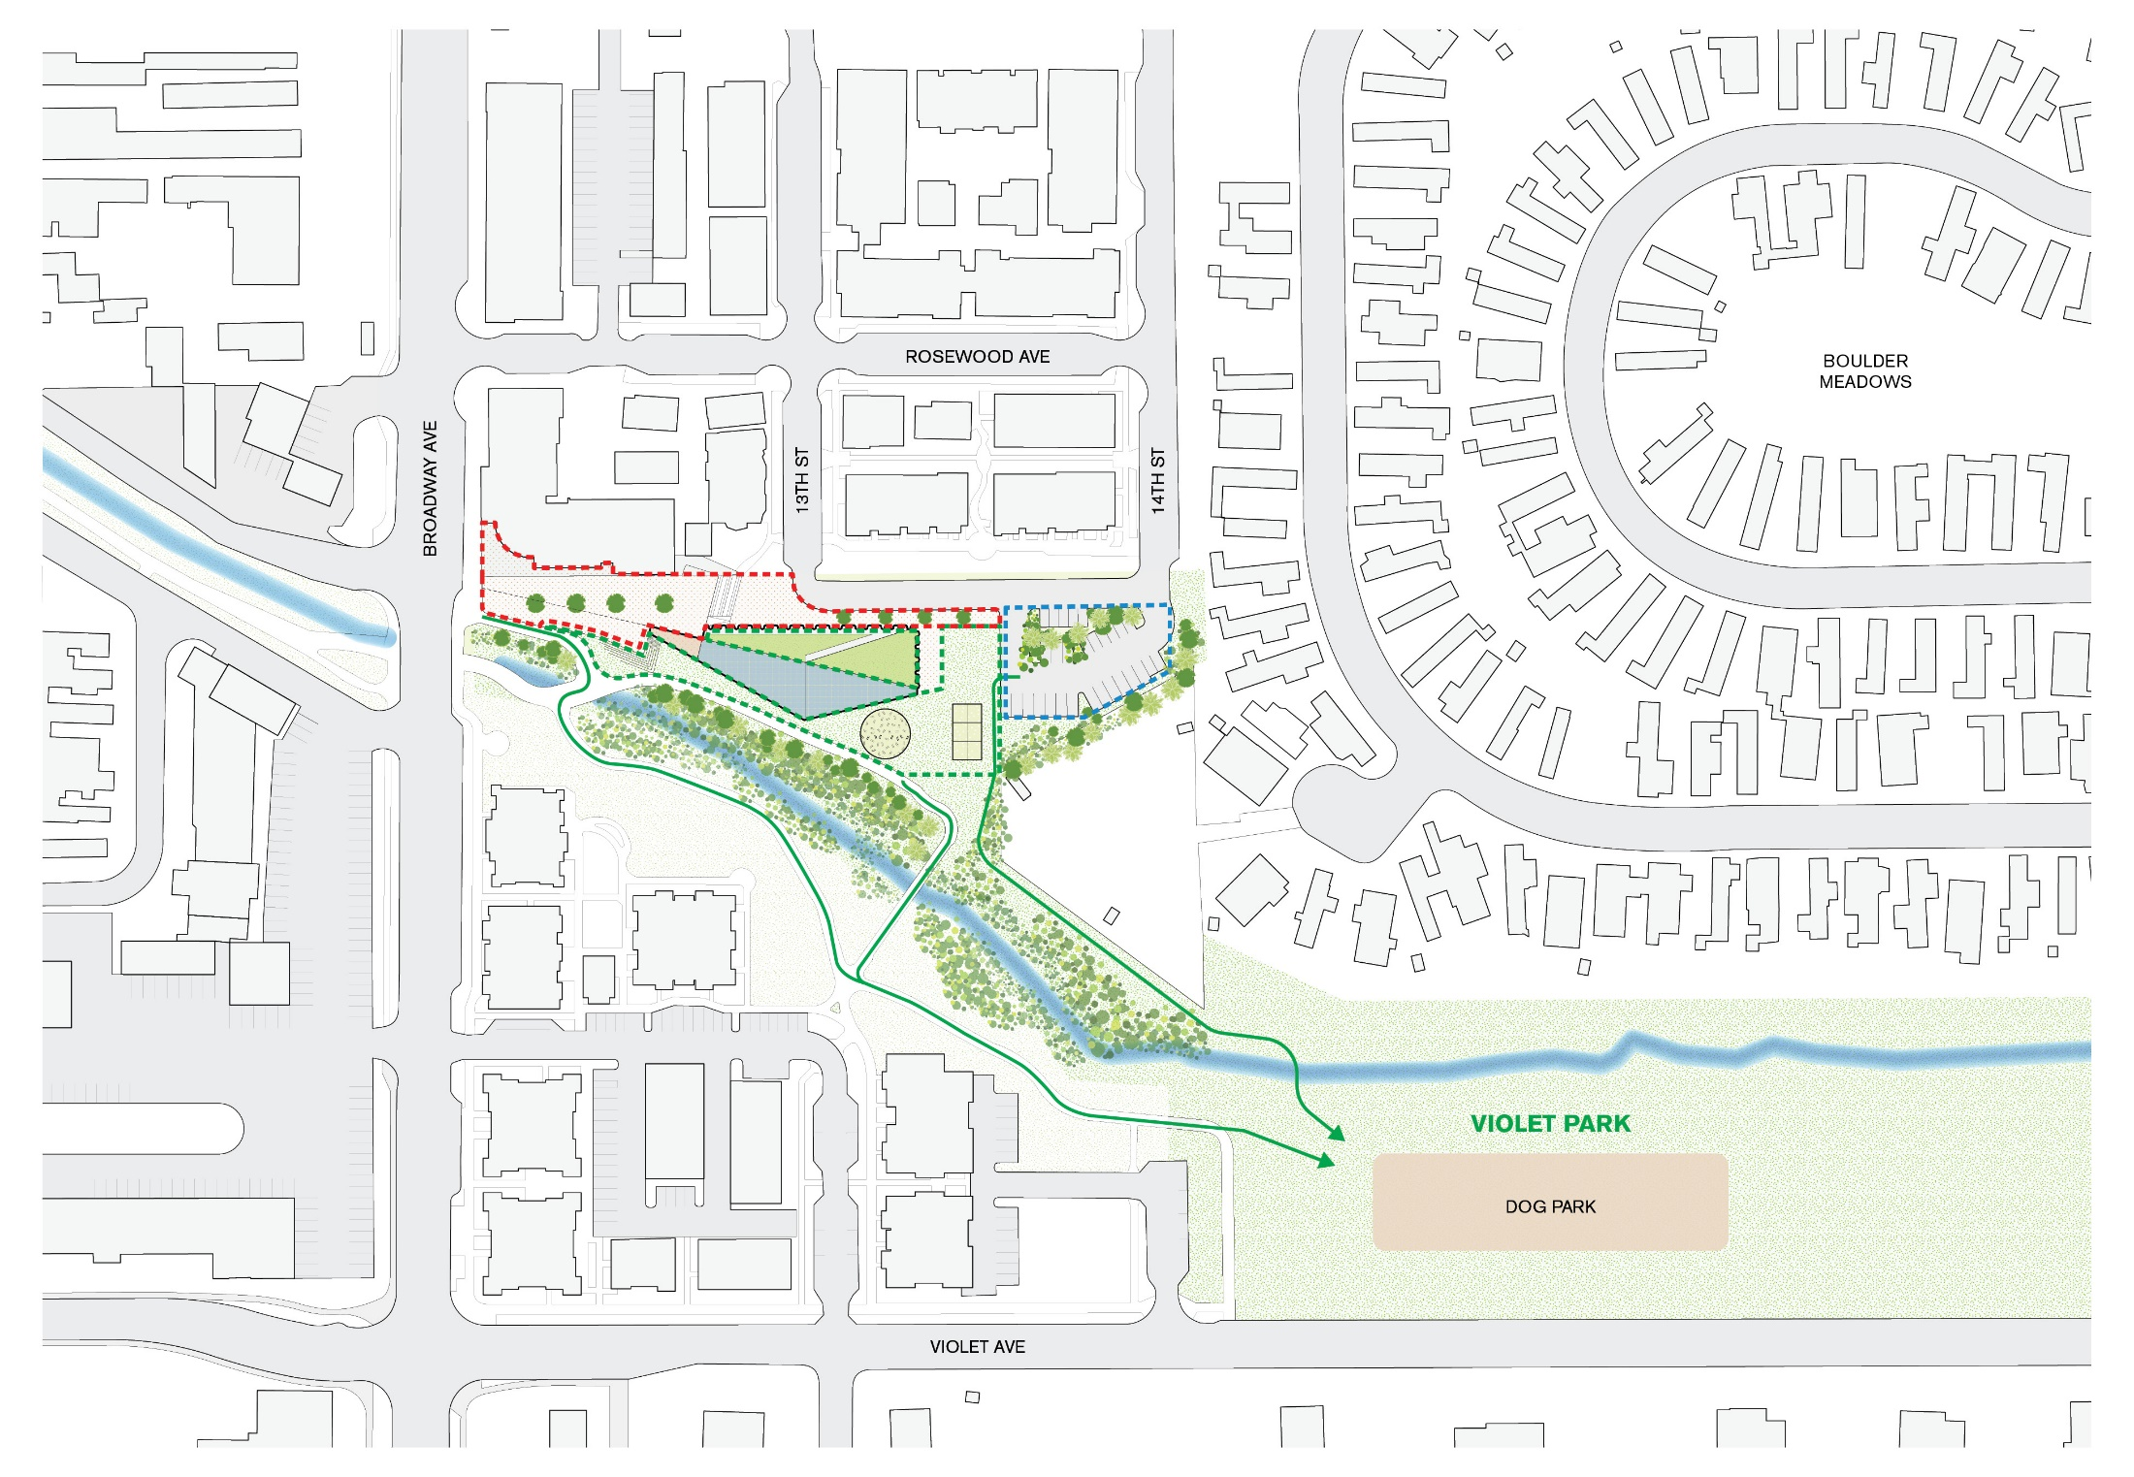
OPEN SPACE (PROPOSED)

Slide 52
II. COMMUNITY ROOMS

Slide 53
PLAN 1

Slide 54
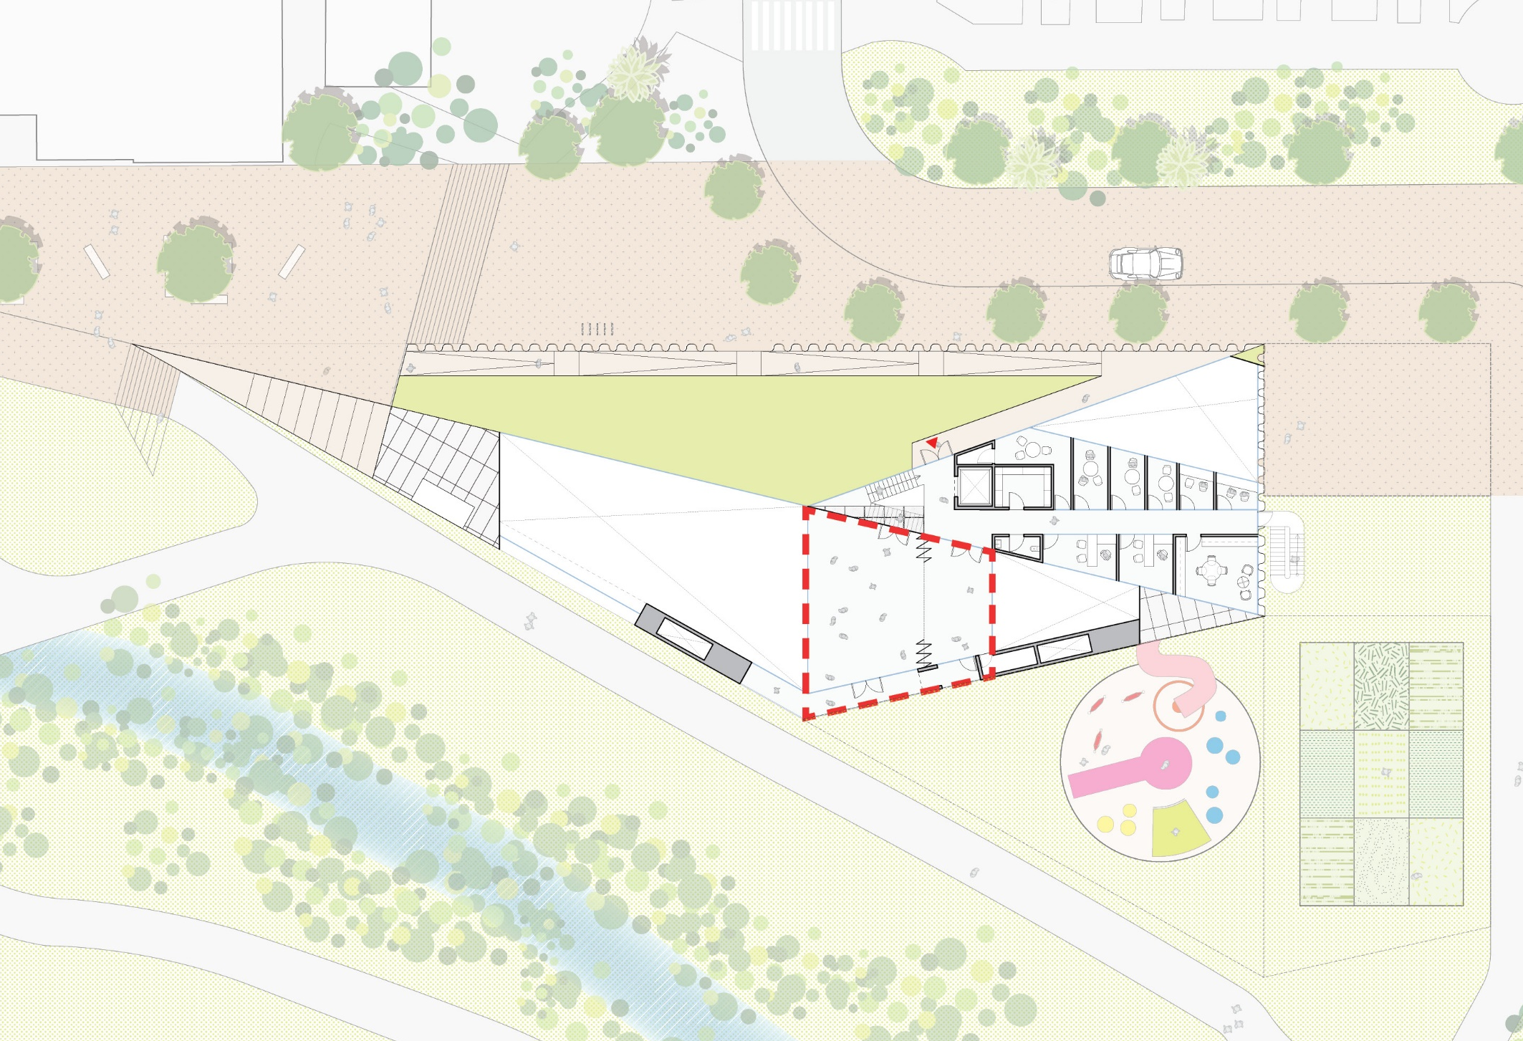
2nd FLOOR COMMUNITY

Slide 55
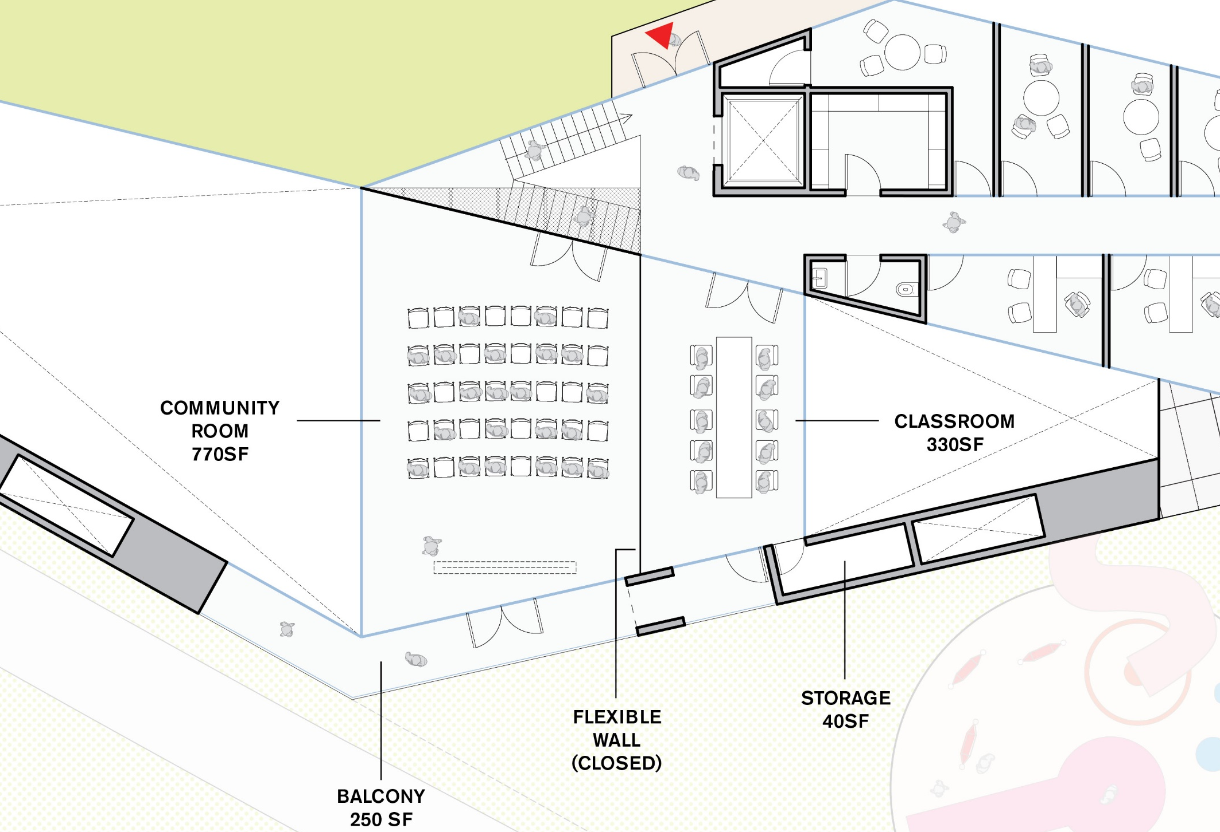
SPLIT ROOMS

Slide 56
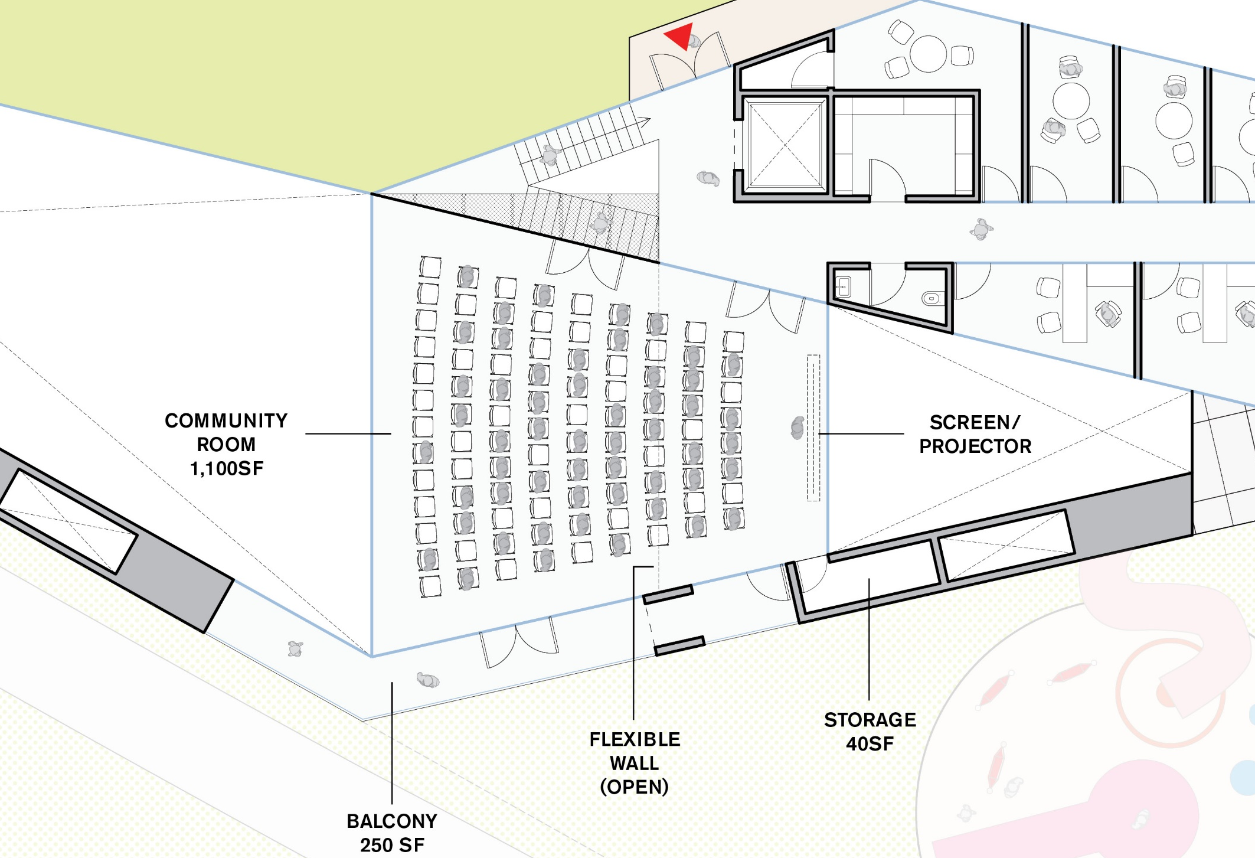
LARGE EVENT

Slide 57
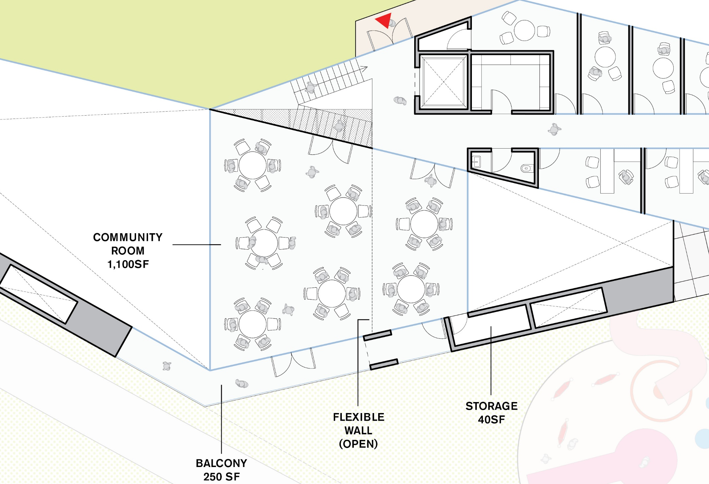
BANQUET

Slide 58
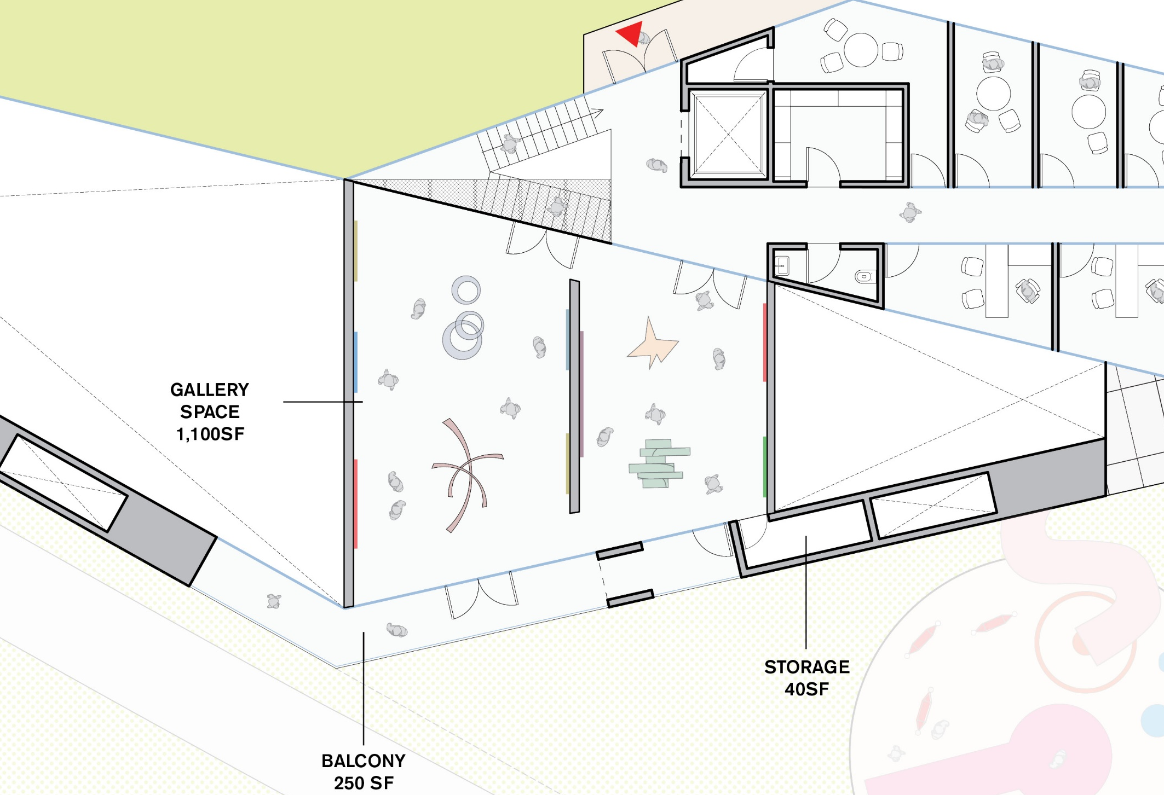
GALLERY

Slide 59
III. MAKER SPACE

Slide 60
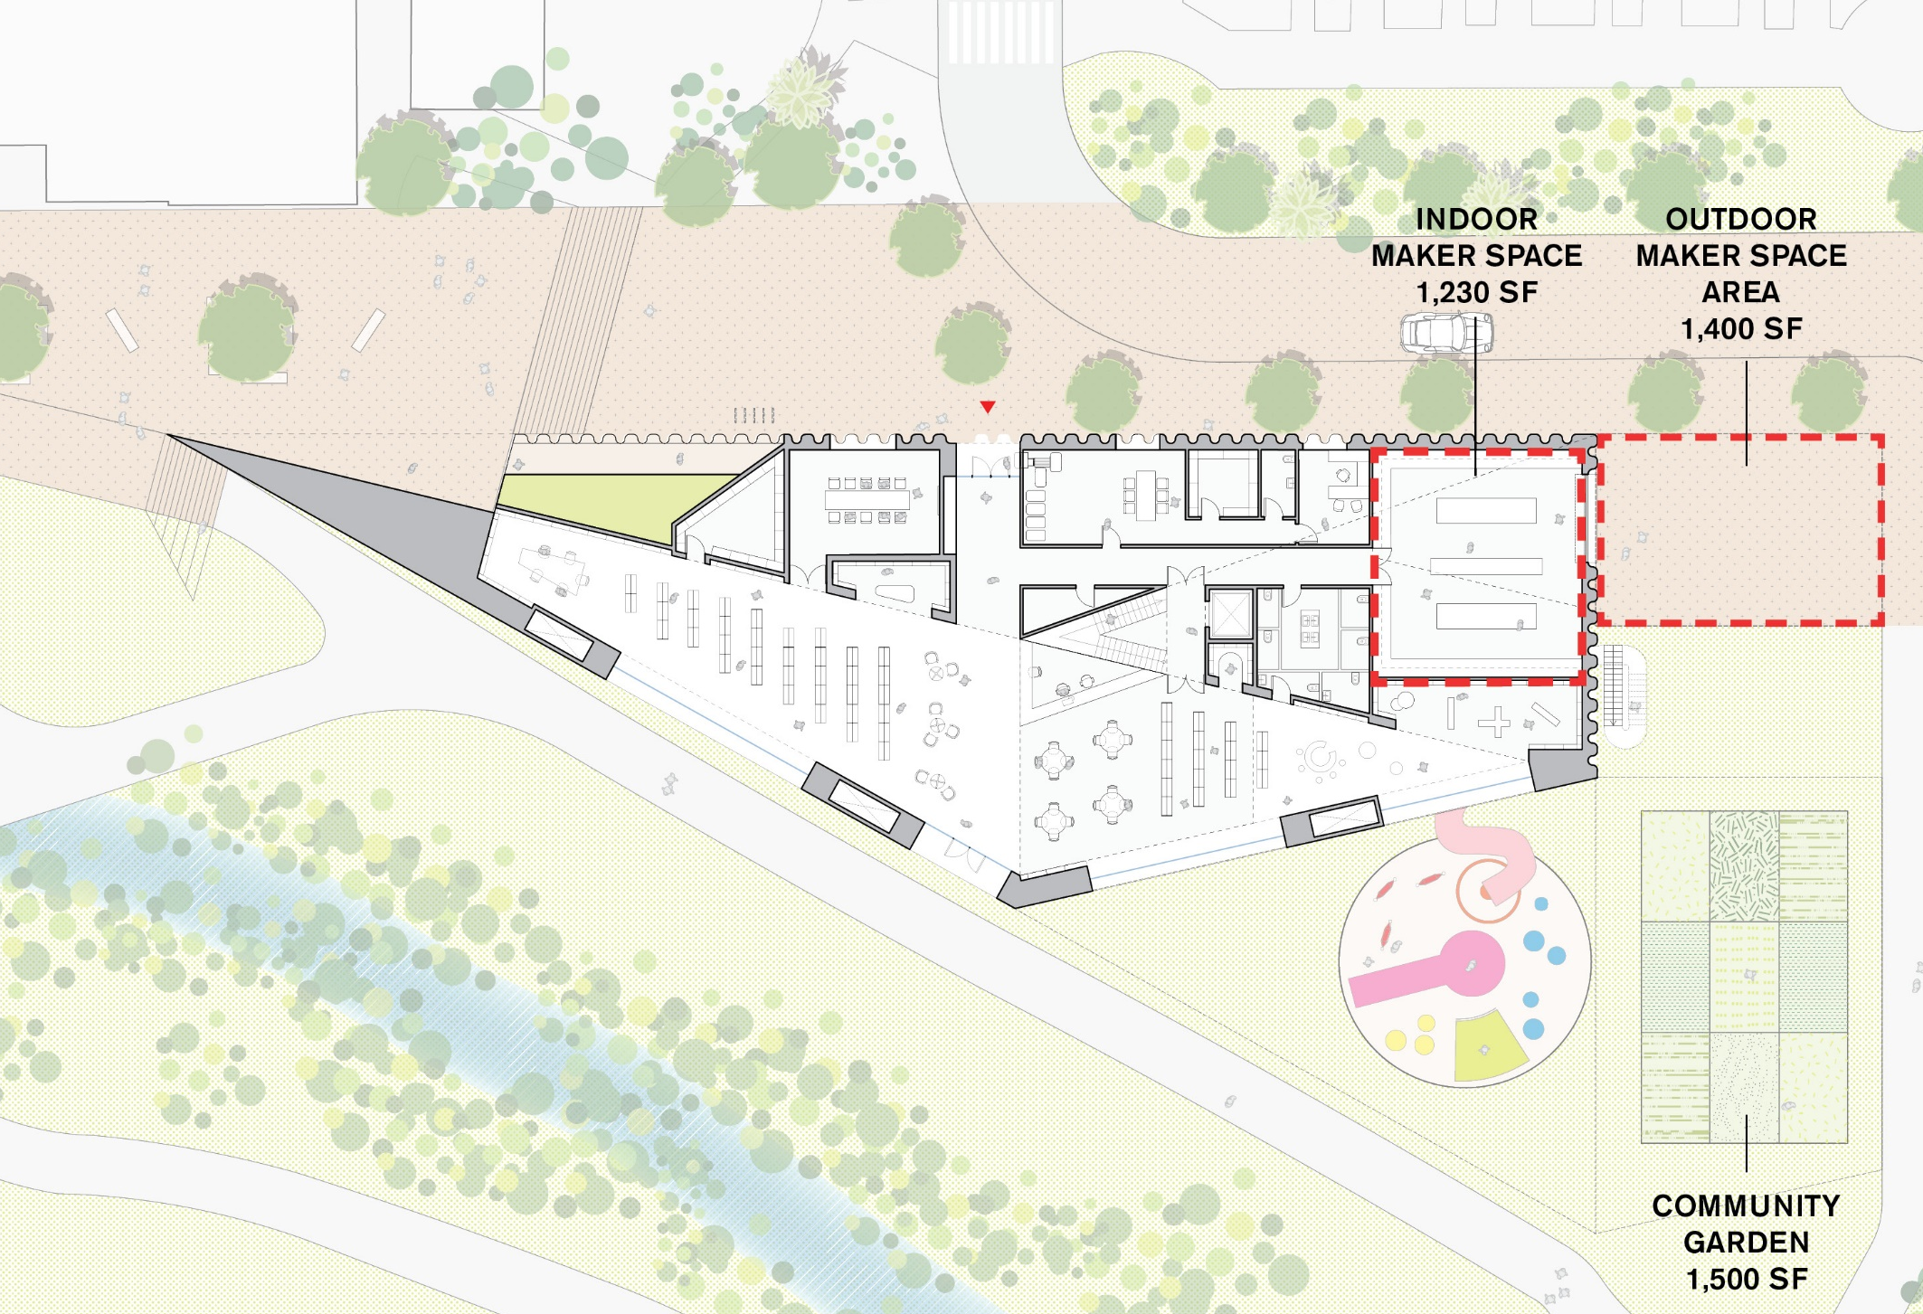
GROUND FLOOR PLAN

Slide 61
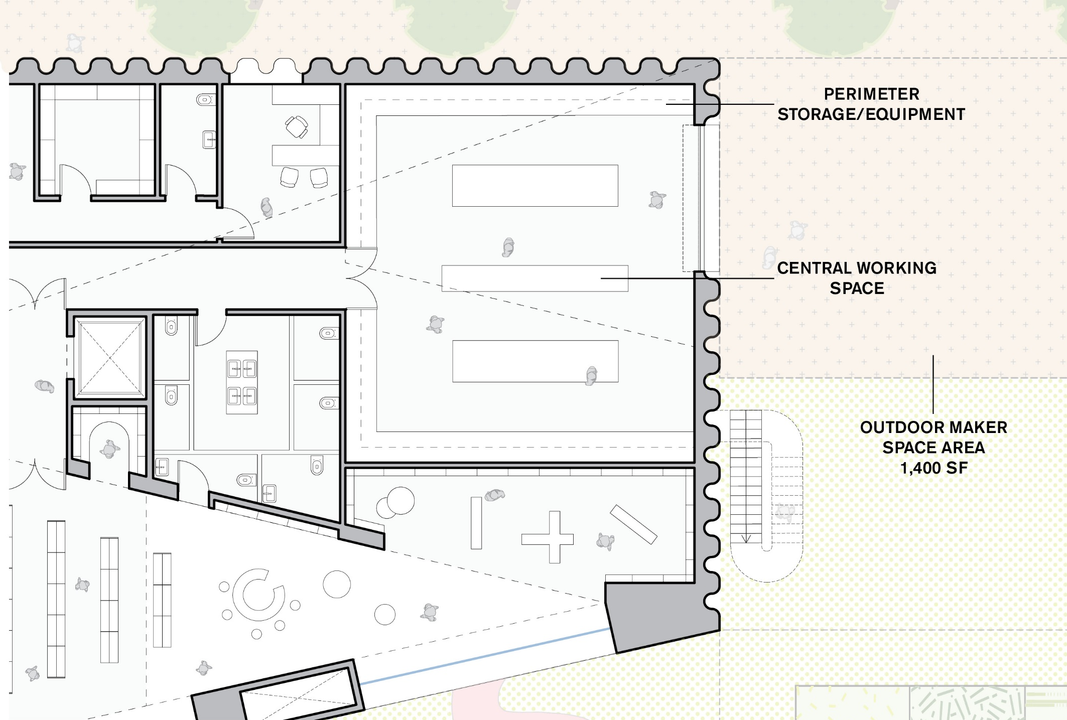
ZOOM IN PLAN

Slide 62
MAKER SPACE OPTION 1:
DESIGN STUDIO

Slide 63
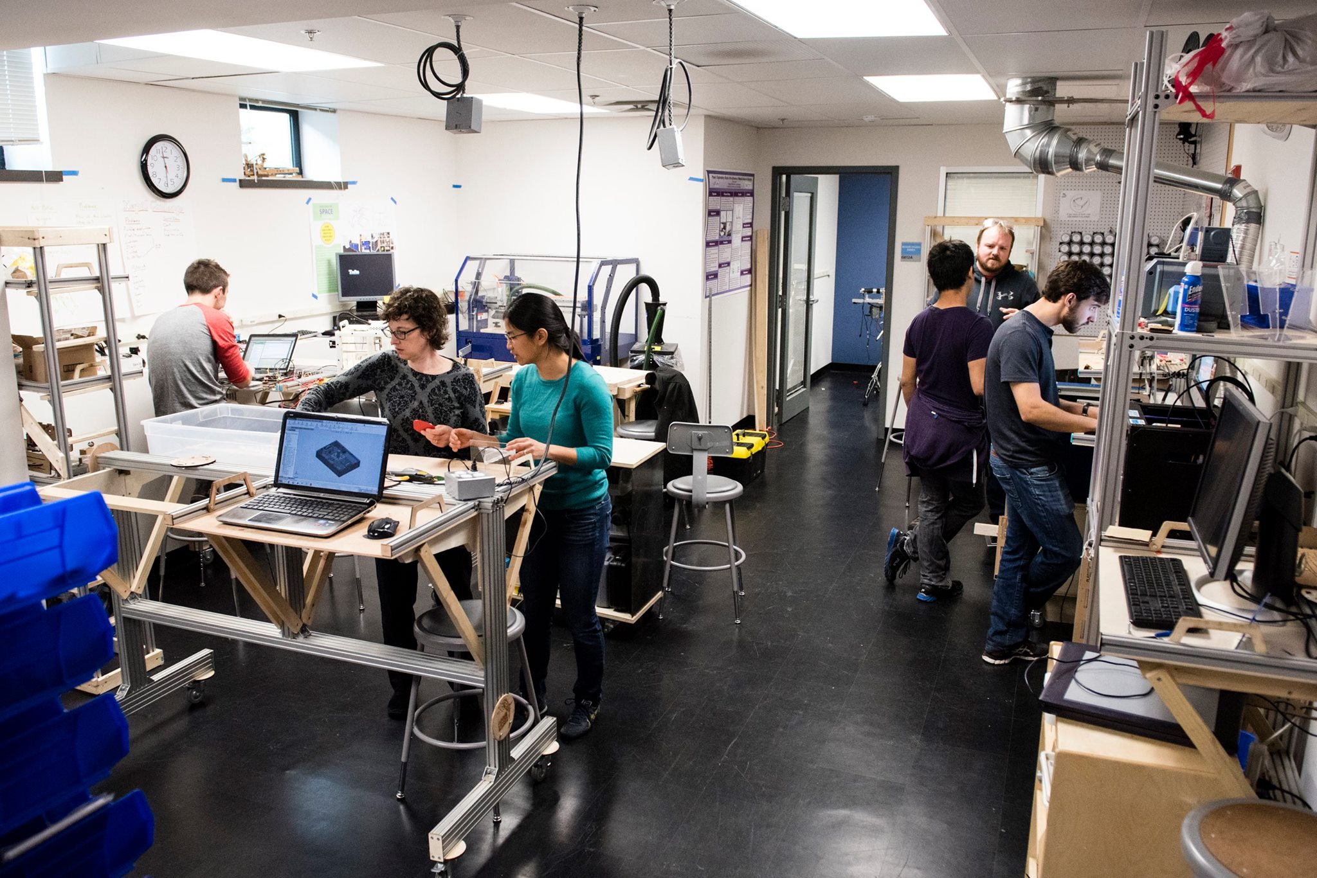

Slide 64
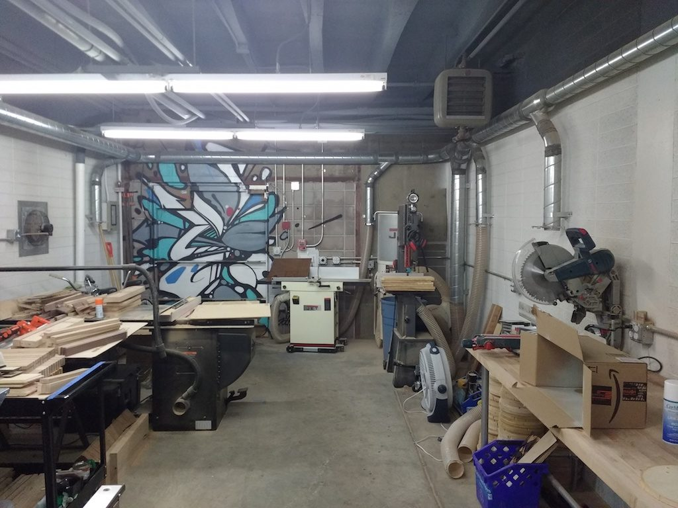

Slide 65
MAKER SPACE OPTION 2:
HOT SHOP

Slide 66
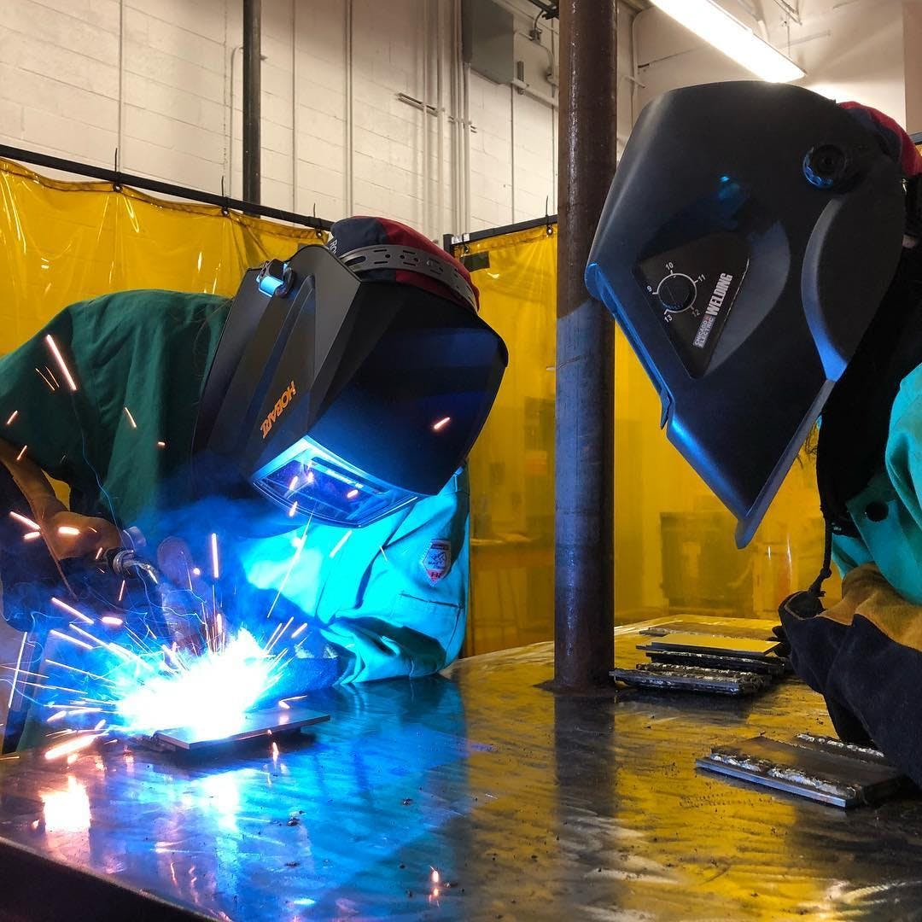

Slide 69
MAKER SPACE OPTION 3:
MAKER KITCHEN

Slide 80
IV. CHILDREN’S AREA

Slide 81
GROUND FLOOR PLAN

Slide 85
CENTRAL STORYTIME

Slide 86
CORNER STORYTIME

