Slide 1
Library District Review
Cost of Library Services
Mill Rate Calculation
Boulder LDAC Meeting 2
October 28, 201

Slide 2
Why? / Problem
Identifying long-term sustainable funding is not a new issue for BPL.
A stated objective in the 2008 Master Plan
A Library District has been discussed in Boulder & environs since the late 1980s
The 2018 Master Plan included extensive community engagement to identify what community members want from BPL. Some programs/services requested include:
The 2018 Master Plan also examined models for long-term sustainable funding to achieve the goals the community requested
After nearly two years of comparing different models & methods to obtain long-term sustainable funding including a variety of dedicated taxes, the Library Commission unanimously recommended that a Library District was the most "equitable and fair“ option.
A financial, governance & legal analysis was conducted at Council’s request & culminated in the sample IGA which Council & the City Manager have asked the LDAC to provide feedback & recommendations on.
A NoBo Branch Library | A Gunbarrel Corner Library
Activation of Main Library Canyon Theater | Outreach to underserved community members
 | Funding sufficient to take care of the current buildings

Slide 3
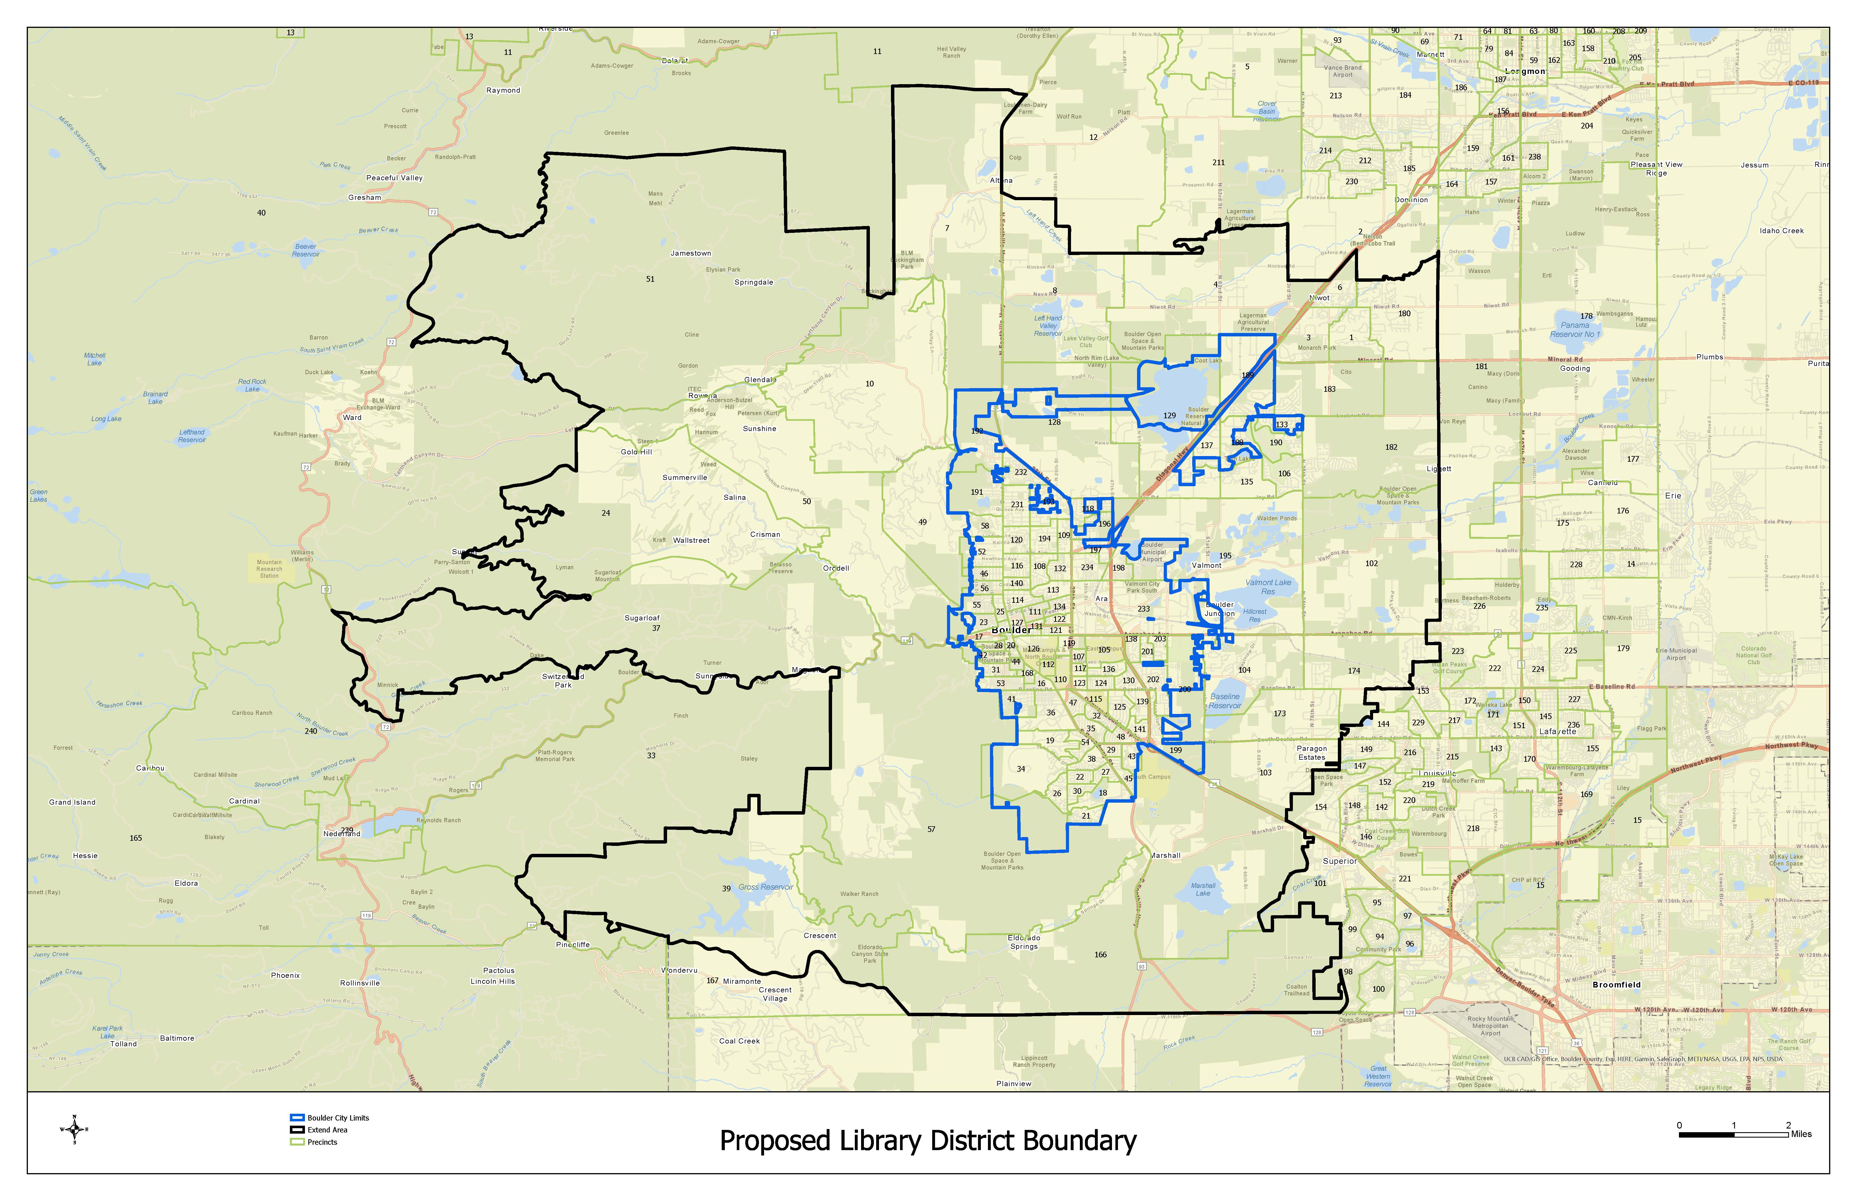
What is a Library District?
Notes:
Chris M. would like to have the city/district overlay map here to explain what a district is, ie. the city provides x,y,z services. if a district were formed the district would lay over like..... and provide library services only.

Slide 4
What do Library Districts do?
Provides Library Services within its Boundaries!
Board of trustees
Taxation
Budget
Policies and Strategic Direction
Management
  Hires, supervises and evaluates the Library Director
  Sets broad program and policy direction
  Commuicates with the with the community

Slide 5
Establishing a Library District
Ordinance/ Resolution
Petition
Boundaries &
Proposed Mill Levy
100 Signatures
Boundaries &
Proposed Mill Levy
Appoint a Board of Trustees (5-7)
District Established or referred to voters
IGA within 90 days for Board Appointments
Formation Election
TABOR Election
To Establish Mill Levy
Notes:
Steve Catanach

Slide 6

Library
Services, Costs &
Mill Levy
Notes:
Provide information about:
Total cost of service - how much does it cost to provide library services – which depends on services and service levels
Library funding scenarios – where we present different funding options –
Potential impact to the city budget if a library district is formed
End with putting this funding discussion in the context of other potential financial matters

Slide 7
LDAC Discussion Questions
Are the services outlined in the 2018 Master Plan the correct level of service for a Library District?
Is the projected mill rate for the Library District adequate to meet the Master Plan goals?

Slide 8
Current Funding for Library Services
  Direct cost for library services $8.7 million
  Staff + benefits, Books, subscriptions, library technology, etc.
  Internal Cost Allocation $3.6 million
  COB’s cost for Facilities & Maintenance, IT, Communications, HR, Payroll, Finance, Legal, etc.
  Capital Improvement $1.02 million

Slide 9
Library Master Plan Projected Cost of Service
Current Budget
  2022 Operating Budget (General Fund $7.4M, Library Fund $1.4M) $8.7M
  Administrative Overhead/Cost Allocation (General Fund) 3.6M
  $12.3M
Unfunded Needs to Meet Community Demand Service Level
  Budget Gap Due to Covid-19 $0.3M
  North Boulder (NoBo) Library Operating [2023] 1.0M
  Deferred Capital Maintenance 2.3M
  $3.6M
Unfunded Needs for Expanded Service Level
  Operating and Capital $4.1M
$15.9M
$20.0M

Slide 10
2018 Library Master Plan Goals
North Boulder Library Branch
Gunbarrel Corner Library
Outreach to underserved populations
Adequate resources for collections [books, audios, movies, etc.]
Activate Canyon Theater
Carnegie Library for Local History restoration
Expand programs [literacy, maker, educational]
Maintain library facilities

Slide 11
BPL Master Plan Library District Costs
ADDRESS COMMUNITY DEMAND LEVEL
NoBo Branch Library
Estimate annual operating costs $1 million
Capital for completing building with green energy elements (solar panels) & site work (connecting plaza & playground)
                $2 – 3 million
Facilities Capital and Maintenance
Address deferred maintenance annually over 15 years
$1.2 million
Build a capital reserve fund for build maintenance annually over 15 years
$1.1 million
Develop Operating Reserve Fund
Library Districts are required by statute to carry 3% reserve funding.
Consistent with best practices, it is recommended that Boulder Library District builds & maintains a 15% reserve fund.
SERVICE EXPANSION LEVEL
New Services & Improvements
Corner libraries in Gunbarrel & Niwot
Capital $1 million
Annual Operating $800 thousand
Expand outreach program to reach Latinx community
Annual Operating $250 – 350 thousand
Carnegie Library Facility & Staffing Improvements
Capital $1 million
Annual Operating $200 thousand
Activation of the Canyon Theater
Capital $1 million
Annual Operating $200 thousand

Slide 12
Mill Rate Equivalents for Library Services
MAINTAIN SERVICE LEVELS
Operate the library at current level BASE 2.7 mills
ADDRESS COMMUNITY DEMAND
Operate full-service NoBo Branch Library + 0.18 mills
Address deferred maintenance, build capital & operating reserve + 0.54 mills
SERVICE EXPANSION
Open Gunbarrel & Niwot corner libraries + 0.15 mills
Renovate & Activate Canyon Theater + 0.02 mills
Outreach program to reach Latinx community members + 0.07 mills
Renovate & increase staff at Carnegie Library for Local History + 0.06 mills
                TOTAL 3.7 mills

Slide 13
Discussion Questions
Does the LDAC have any questions on the information presented?
Are the services outlined in the 2018 Master Plan the correct level of service for a Library District?
Is the projected mill rate for the Library District adequate to meet the Master Plan goals?

Slide 14
Supplemental Information

Slide 15
Establishing a Library District by Resolution/Ordinance
The establishing entities determine the appropriate boundaries.
Public hearing; or 90 days written notice of the proposed establishment to other “governmental units.”
The resolution or ordinance must describe:
  the district’s legal service area; &
  identify & provide that the electors must approve the proposed mill levy.
The establishing entities appoint the first 5 to 7 member Board of Trustees for the library district.

Slide 16
Adoption of the Resolution/Ordinance
Within 90 days enter into an intergovernmental agreement (IGA)
  Establish a deadline to obtain funding by the TABOR Amendment.
  Provide terms to transition library services from the establishing entities to the district:
    Any conveyance by donation or sale of real or personal property used to provide library services;
    The transition of library employees from the establishing entity to the library district
    Interim funding, if any;
    Administrative, maintenance, personnel, procurement, insurance, employee benefits, etc. through contract with an establishing entity;
    Establishing procedures for future library trustee selection; and
    Generally providing for a mutually beneficial relationship or separation.
    If the district does not obtain funding, the IGA may require it to dissolve.

Slide 17
Establishing District by Petition or
Registered Electors
100 electors residing in the proposed library district “service area” can trigger an election to form a district by petition.
The petition is addressed to the County Commissioners and must be filed at least 90 days before a TABOR election.
The petition must comply with C.R.S. § 24-90-107(3)(a), including a request for establishment of the district, name of the district, the governmental units involved and contain a description of the “service area” and proposed mill levy.
A bond must be filed to pay election expenses in the event the election is unsuccessful unless waived by the county.
Once in receipt of the petition, the establishing entities must:
  pass a resolution or ordinance establishing the district; or
  submit the question of establishment to a vote.
After a successful election, library trustees must be appointed and an IGA is to be negotiated to address the matters discussed above.
A TABOR election will be required to establish the mill levy.

Slide 18
Estimated Annual Library District Budget
  Personnel salary & benefits 58-62 %
  Library materials 10 %
  Books, movies, database subscriptions
  Operating expenses 23-27 %
  Maintenance, technology, furniture, HR, payroll, finance, legal, etc.
  Equipment replacement 5 %

Slide 19
Estimated Annual Library District Expenditures
Annual operating budget to fund Master Plan through the “Service Expansion” level = $14 million
Personnel salary & benefits $8.4 million
Facilities capital & maintenance $2 million
Library materials $1.2 million
Technology $1 million
Replacement costs $0.5 million
Administrative costs $0.8 million
Communications, Legal, HR, Payroll, Risk, Finance, paper, software, etc.

Slide 20
Library District Funding within Proposed District Boundary
Funding the 2018 BPL Master Plan through the
“Service Expansion” level requires 3.7 mills.
Annual Tax Revenue Generated
1 mill = $5.4 million
3.7 mills = $19.98 million

Slide 21
Individual Property Owners’ Cost for a Library District
Funding a Library District represents an approximate average increase of 4% in property taxes for residential & commercial properties within the proposed district boundaries.
Property Tax Cost Increase for 3.7 mills
$26 per every $100 thousand of residential property value
$104 per every $100 thousand of commercial property value
*The cost for property owners within the COB limits may be less if the current 0.333 mill property tax levy dedicated to library services is removed.

Slide 22
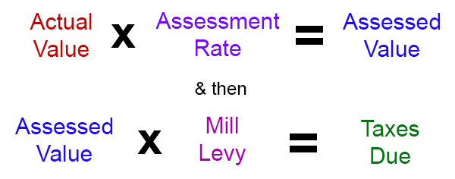
Calculating the Mill Rate for Your Property
Link to Calculating Your Property Taxes brochure.
Credit: Boulder County Assessor’s Office Webpage

Slide 23
City of Boulder Sales and Property Tax History
Budget Office
October 2021
Slides 23 through 27

Slide 25
Sales Tax Increase – Recent Ballot History
The 0.15% Sales and Use Tax component was originally dedicated to the Public Safety Fund and moved to the General Fund for public safety purposes and extended until 2024, at which point it expires.
In 2013, voters approved the extension of the 0.33% for Open Space from 2014 through 2018; 0.22% for Open Space and 0.11% for General Fund purposes from 2019 through 2034; 0.10% for Open Space and 0.23% for General Fund purposes starting in 2035 and beyond.
In 2013, voters approved the extension of the 0.15% Sales and Use Tax for Open Space until 2019 at which point it would shift to Transportation for 2020 through 2029, and then shift to General Fund purposes for 2030 to 2039, expiring at the end of 2039.
At the same time in 2013, a temporary 0.15% Sales and Use Tax for Transportation was approved by voters to bridge the gap until 2020 when the 0.15% Sales and Use Tax for Open Space (previous sentence) shifted to Transportation. In 2019, that 0.15% temporary Transportation tax was extended and repurposed to the Open Space Fund and expires at the end of 2039.

Slide 26





Property Tax Overview
Type of Citywide Property Tax | Mill Levy
General Fund | 7.948
General Fund – Public Safety | 2.000
Library | 0.333
Parks & Recreation | 0.900
Community Housing Assistance Program | 0.800
Total City of Boulder Mill Levy | 11.981
For every property tax $ collected in Boulder:
Boulder County Schools:
57¢
Boulder County:
27¢
City of Boulder: 14¢
Special Districts: 2¢
City of Boulder property tax rate has not been increased since 1991
  Community Housing Assistance Program
There are several overlapping city-operated taxing entities
  General improvement districts in University Hill, Downtown, Boulder Junction, and Forest Glen
Community Housing Assistance Program: 1¢
Parks & Recreation: 1¢
Library: <1¢
General –
Public Safety: 2¢
14¢
General: 9¢
Notes:
City receives 14 cents of every dollar of property tax collected. The largest portion of tax collected is for schools.
Properties are assessed every other year. City property tax revenue is split between several funds including the General fund, Library Fund, Parks and Recreation Fund, and the Community Housing Assistance Program Fund.
The city’s mill levy rate is 11.981 mills and city charter allows for a mill rate up to 13 mills

Slide 27
Revenue Generation for the City of Boulder
Based on 2022 revenue projections, a 0.10% sales and use tax generates approximately $3.65 million.
Based on 2021 property tax projected collections, each mill generates approximately $4.21 million.

Slide 28
Library Funding Scenarios
No. | Governance | Funding Source | Service Level | Total Cost | Dedicated Property Tax (Mills) | $ Impact on Residential Property Tax Bills ($850K Market Value)
1 | Library District | Dedicated Property Tax | Expanded | $20M | 3.85 | $234 County $214 City
2 | Municipal | Dedicated Property Tax | Expanded | $20M | 4.56 | $257
3 | Municipal | Dedicated Property Tax | Meet Community Demand + Deferred Capital Maintenance | $15.8M | 3.53 | $194
4 | Municipal | Current Funding + Additional Increments of Dedicated Property Tax | Current Service level & Admin Overhead Fund COVID-19 gap NoBo operating Deferred Capital Maintenance | $11.2M $1.3M $1.0M $2.3M | General Fund + 0.333 mills 0.32 mills additional 0.24 mills additional 0.56 mills additional | $19 $15 $34
Notes:
This slide presents different funding options that have been discussed. Will walk through this slide scenario by scenario.
Scenario 1 is a library district funded by a dedicated property that would fund an expanded service level generating ~$20M/year – with the boundary shown on the previous slide, the mill levy needed to generate $20M is estimated to be 3.85 mills. To demonstrate the impact of the 3.85 library district mill levy on residential property owners – in the last column we assumed residential property with a market value of $850K. For properties in the county this would be an increase of 3.85 mills so the impact would be $234 increase in their annual property tax bill (~4%). For properties within the city we assume these property owners would also have only be assessed a total mill levy of 3.85 for the library – so the city’s current mill levy dedicated to the library of .333 would go away so the net mill levy increase for properties in the city would be less – a 3.517 increase so the impact would be - $214 increase to the property tax bill within the city (~4%).
Net mill levy increase to property owners in the city is (3.85-.333=3.517)
Scenario 2 is to demonstrate if the city’s municipal library had a dedicated property tax that would fund the total cost of an expanded service level generating ~ $20M/year – which would apply only to properties within the city – the mill levy needed to generate $20M is estimated to be 4.56 mills which would result in a $257 increase to annual property tax bills on a property with a market value of $850K (~ 5.3%).
Scenario 3 is a funding scenario where the city’s municipal library had a dedicated property tax that would fund the total cost to the meet community demand service level (as defined in the master plan) and deferred capital maintenance - which would require funding the budget gap from COVID-19 reductions, and funding North Boulder operating. That total cost as we discussed two slides previous is $15.8M and includes the amounts for administrative overhead. The mill levy needed to generate $15.8M is estimated to be 3.53 mills which would result in a $194 increase to annual property tax bills on a property with a market value of $850K (~4.1%).
Scenario 4 is a hybrid scenario of current undedicated funding and potential additional increments of dedicated property tax. So we will walk through each line -
the first line of Scenario 4 assumes the city’s general fund and the current 0.333 dedicated mill levy would support the funding level in the current 2021 budget of $11.2M which includes the general fund support for administrative overhead. The next three lines are potential dedicated property tax increments to fund service level increases.
So to fund the COVID-19 budget gap of $1.3M with a dedicated mill levy would require 0.32 mills and have a $19 annual impact to property tax bills on a property with a market value of $850K (0.37%).
to fund NoBo operating of $1.0M with a dedicated mill levy would require 0.24 mills and have a $15 annual impact to property tax bills on a property with a market value of $850K (0.29%).
to fund Deferred capital maintenance of $2.3M with a dedicated mill levy would require 0.56 mills and have a $34 annual impact to property tax bills on a property with a market value of $850K (0.66).
0.56 is the increment over current 0.333 mills to fund $1.3M Covid Gap (0.32 mills equivalent) and $1.0M NoBo operating need (0.24 mills equivalent). Assumes all other (GF) funding remains constant. If not, to raise $10.1 million for library total dedicated mills needs to grows to 2.46 mills with $149 impact on residential property owner.
Percentage tax increases to city and county property owners:
3.85 mills* - 4.4% to city | 4.2% to county
4.86 mills* – 5.3% to city
3.53 mills – 4.1% to city
0.24 mills – 0.29% to city
0.32 mills – 0.37% to city
0.56 mills – 0.66% to city
*expanding the boundary to the county saves the city taxpayer about 20-25%
If fully dedicated funding is pursued, administrative overhead will be paid by library either through cost allocation charges if the department stays in the city, or potentially through contracted charges with the city.
The property tax rate on commercial property is 4x that of residential based on assessment (7.15% vs. 29%) and the average commercial market value in Boulder is $3.3M.
Impact on commercial property tax owners is approximately 16x that of the residential values shown above.
Full funding" includes:
-completion of the NoBo branch (with maker space and outside playground);
-expanded collections and materials;
-more accessibility for the Canyon Theater and gallery space;
-a Gunbarrel corner library;
-a corner library in Niwot.

Slide 29
Estimated Cost of New Library Facilities
New Full-Service Branch Library*
Capital $12-15 million
Annual Operating $1 million
*Cost for land not included.
Storefront “Corner Library”**
Capital $0.5 million
Annual Operating $325-450 thousand
**Cost for rent not included.

Slide 30
Estimated Cost of New Library Services
Makerspace like BLDG 61
Capital $400 – 850 thousand
Annual Operating $200 – 250 thousand
Outreach to Manufactured Home Communities
& Boulder Housing Partner Sites
  Capital $0 to minimal
  Annual Operating $150-250 thousand

Slide 31
Annual Library Funding
The annual city operating budget includes direct & indirect funding for the library.
Direct costs: personnel, books, furniture, etc.
Indirect costs: Internal Cost Allocation
COB’s cost for Facilities & Maintenance, IT, Communications, Human Resources (HR), Payroll, Finance, Legal, etc.
Capital: Costs vary year to year. Funded by dedicated tax or bonds.
No dedicated capital fund for the library.
Operating reserves: COB maintains 18-20 % as reserves.
  The library does not have a dedicated reserve fund.

Slide 32
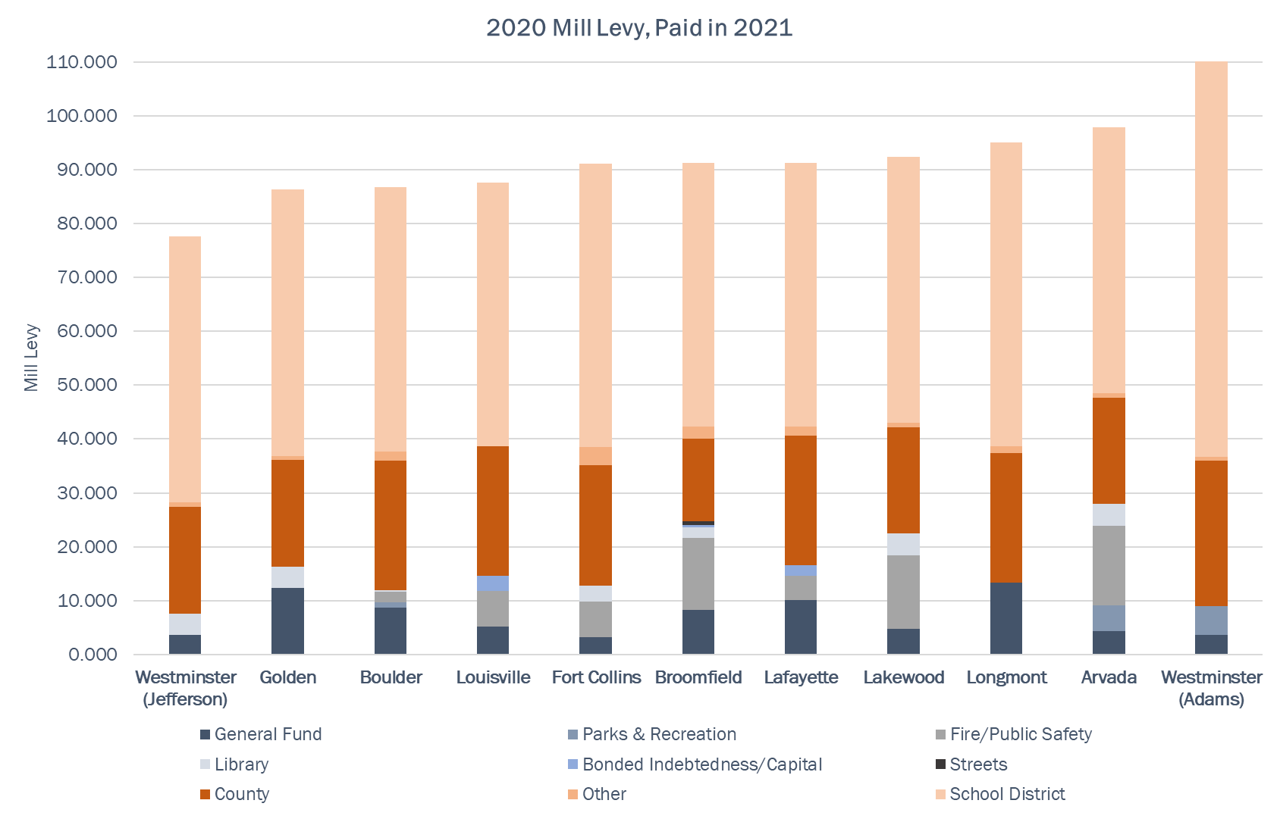
Property tax mill rates for area municipalities

Slide 33
77.625 86.315 86.700 87.613 91.139 91.245 91.291 92.418 94.987 97.915 110.257
Total Mill Levy
7.650 16.340 11.981 14.620 12.790 24.767 16.572 22.443 13.420 27.940 9.063
Municipal Mill Levy
Notes:
Again, this is a comparison of 2020 mill levies for taxes paid in 2021 across peer cities.
For total property tax rates across all taxing jurisdiction in the city – which is the row of total mill levies at the top, Boulder is third from the bottom on the left-hand side of the chart.
The low row of mill levies are the subtotals for typical municipal services whether provided by the local government of through a special district. Library and fire a examples of services that are commonly provided by either the local government or a special district. For this, Boulder is second from the bottom with Westminster being the only local government with a lower local government services mill levy.
Clearly from this you can see that the school districts have the highest mill levy which was reflected on the previous slide.

Slide 34
Current Mill Rates - Colorado Library Districts
Jursidiction | County | Mill Levy
Arapahoe Library District | Arapahoe | 5.875
Douglas County Public Library District | Douglas | 4.000
Estes Valley Public Library District | Larimer | 4.536
High Plains Library District | Boulder | 3.249
High Plains Library District [Greeley] | Weld | 3.249
Jefferson County Library | Jefferson | 4.500
Lyons Public Library District | Boulder | 5.850
Nederland Community Library District* | Boulder | 4.400
Pikes Peak Library District [Colorado Springs] | El Paso | 3.934
Poudre River Library District [Fort Collins] | Larimer | 3.000
Pueblo City-County Library District | Pueblo | 5.889
Rangeview Library District [Anythink Libraries] | Adams | 3.690
* Nederland has an additional 2.015 Mill for a Bond issue bringing their actual mill rate to 6.415
Source: "Certification of Levies and Revenues - As of January 1, 2017" in Colorado Division of Property Taxation: 2016 Annual Report (https://www.colorado.gov/pacific/dola/annual-reports)

Slide 35
Average Mill Rates in Boulder and Unincorporated Areas
According to statute, library districts are funded by voter-approved property tax revenues.
AREA | CURRENT AVERAGE MILL RATE
City of Boulder property owners | 88 mills
Unincorporated Boulder County residential property owners in Gunbarrel & Niwot | 91 mills

Slide 37
